Slide 1
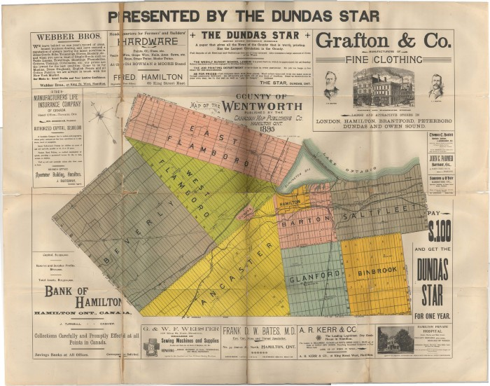
Map (M-0001)
Map of the County of Wentworth

Slide 2
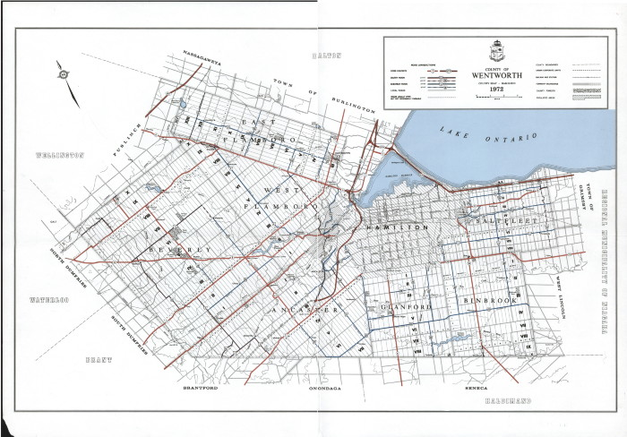
Map (M-0002)
County of Wentworth

Slide 3
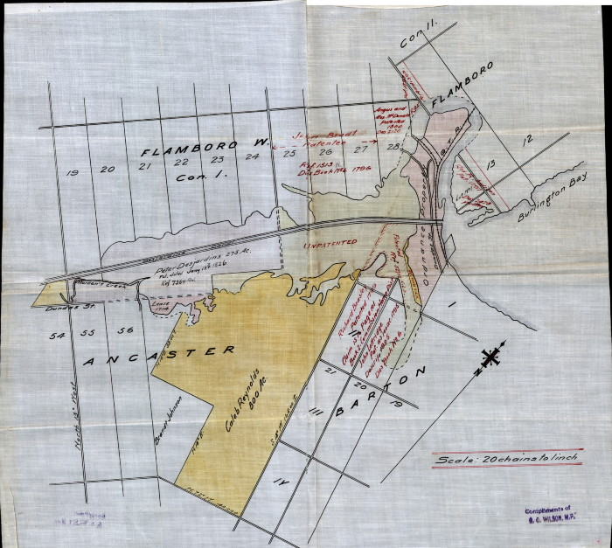
Map (M-0003)
Flamboro, Ancaster, Barton

Slide 4
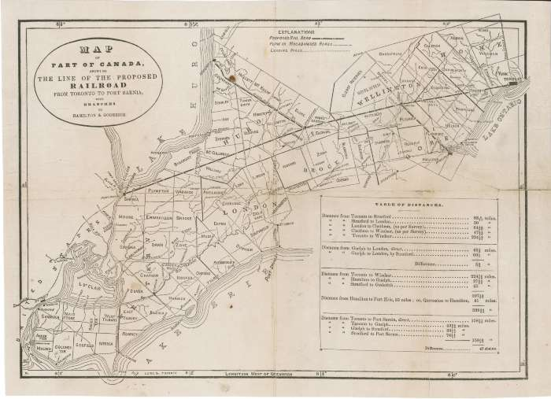
Map (M-0004)
Map of Part of Canada Showing the Line of the Proposed Railroad from Toronto to Port Sarnia, with Branches to Hamilton and Goderich

Slide 5
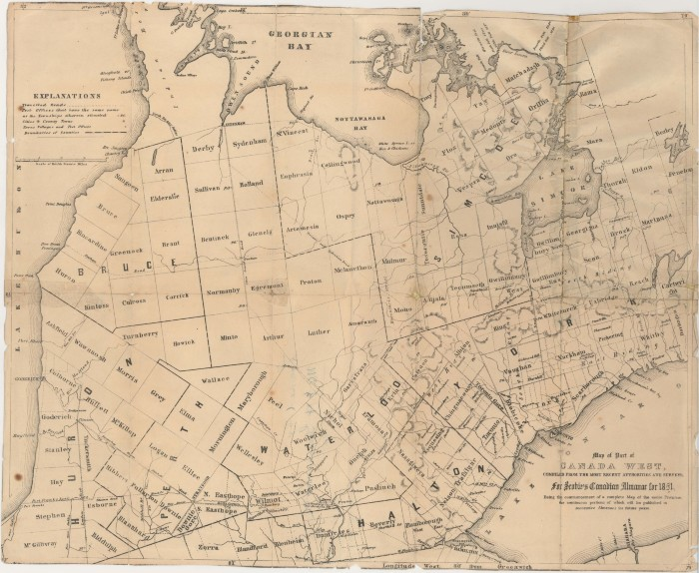
Map (M-0005)
Map of Part of Canada West Compiled from the Most Recent Authorities and Surveys for Scobie's Canadian Almanac for 1851

Slide 6
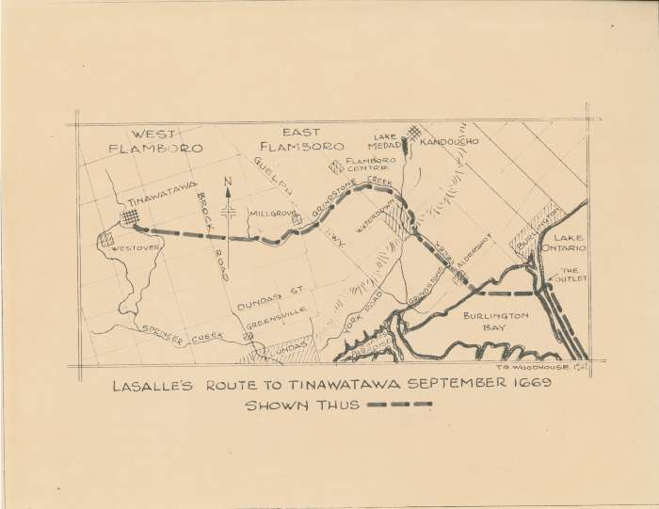
Map (M-0006)
LaSalle's Route to Tinawatawa September 1669

Slide 7
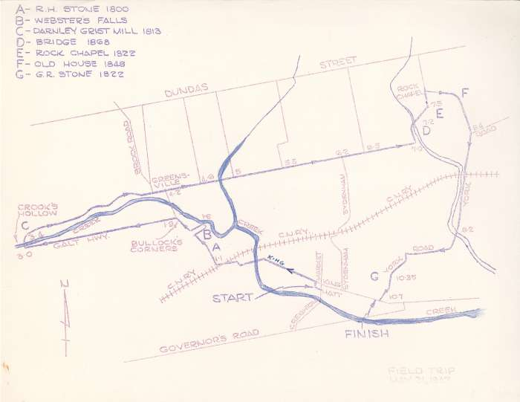
Map (M-0007)
Dundas Field Trip Route

Slide 8
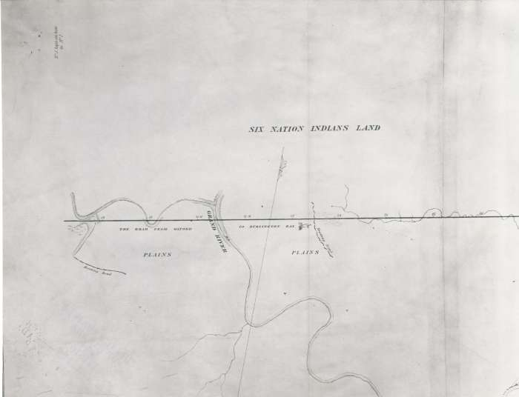
Map (M-0008)
Continuation of the Road from Oxford on the Upper Forks of the River Thames to Burlington Bay, Lake Ontario (I)

Slide 9
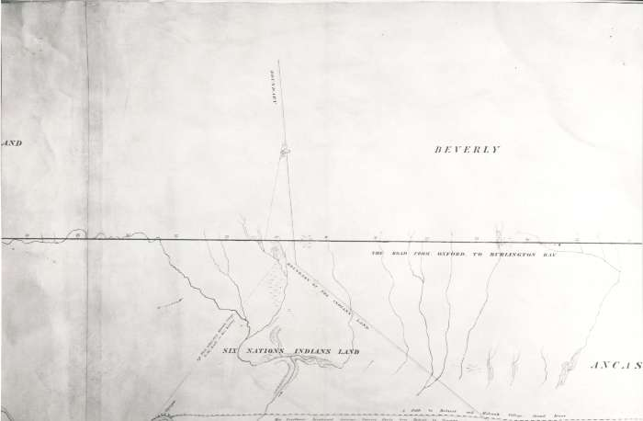
Map (M-0009)
Continuation of the Road from Oxford on the Upper Forks of the River Thames to Burlington Bay, Lake Ontario (II)

Slide 10
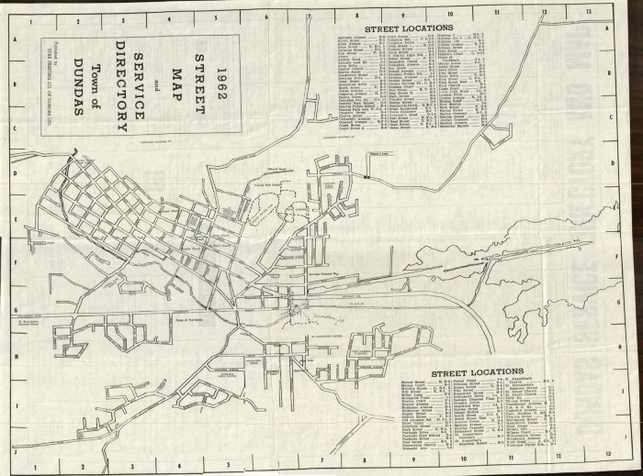
Map (M-0010)
Street Map and Service Directory

Slide 11
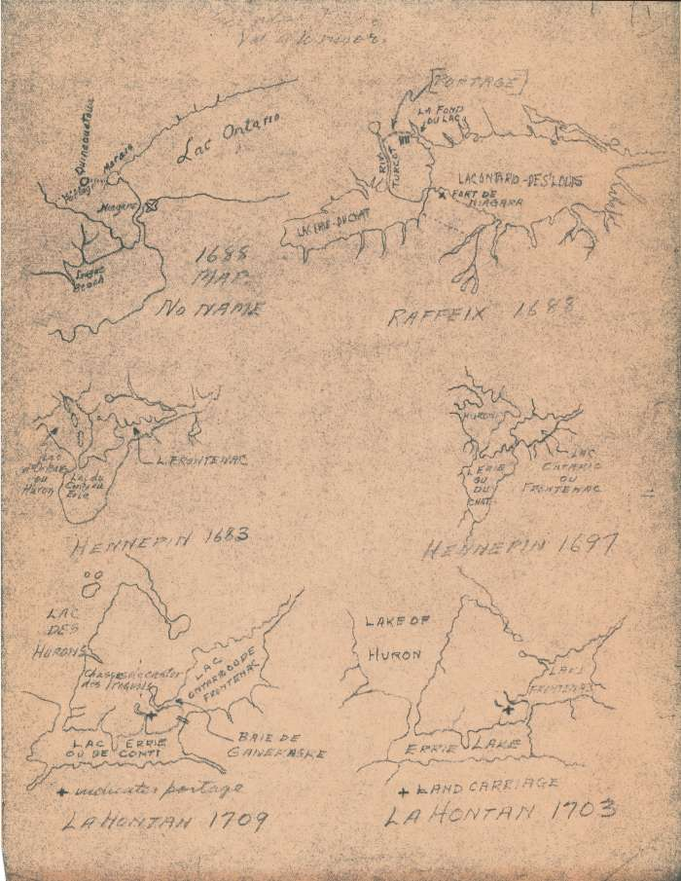
Map (M-0012)
Selection of 17th and 18th Century French Cartography in Canada

Slide 12
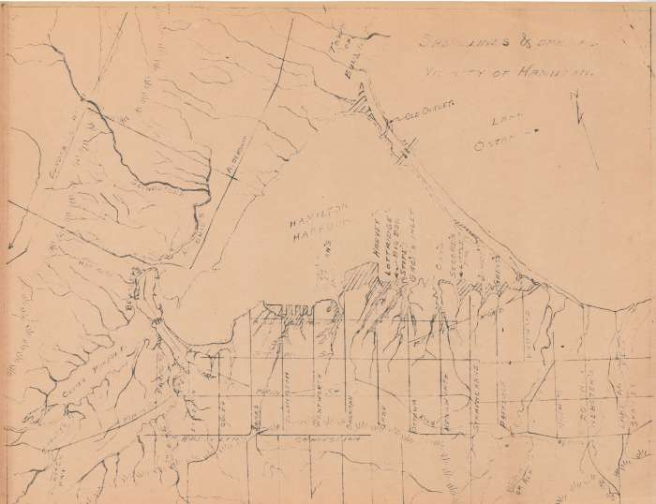
Map (M-0013)
Shorelines and [Drainage] Vicinity of Hamilton

Slide 13
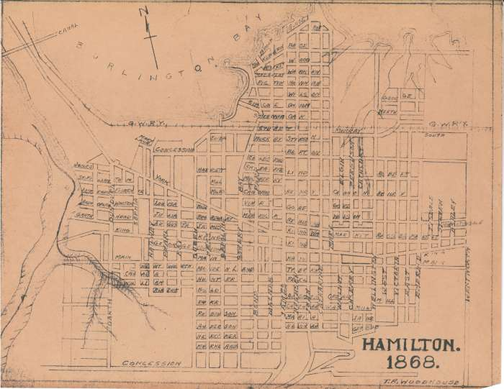
Map (M-0016)
Hamilton 1868

Slide 14
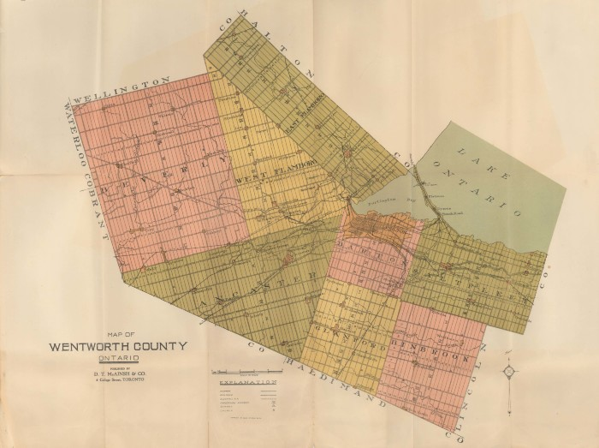
Map (M-0018)
Map of Wentworth County, Ontario

Slide 15
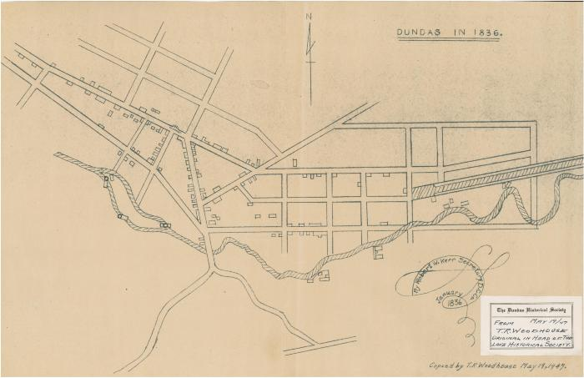
Map (M-0019)
Dundas in 1836

Slide 16
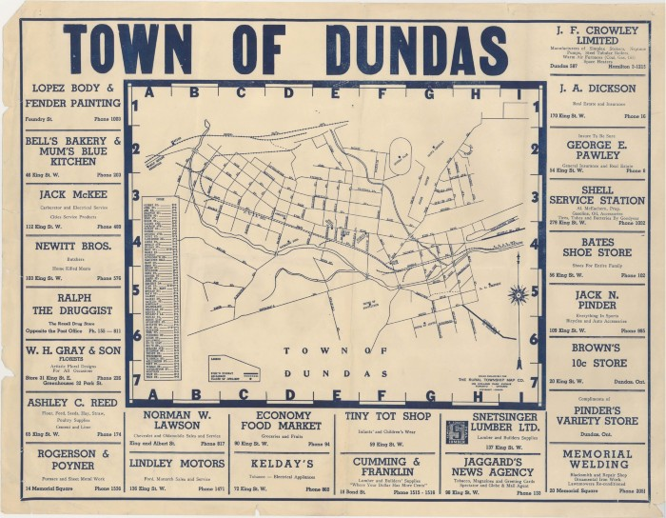
Map (M-0024)
Town of Dundas

Slide 17
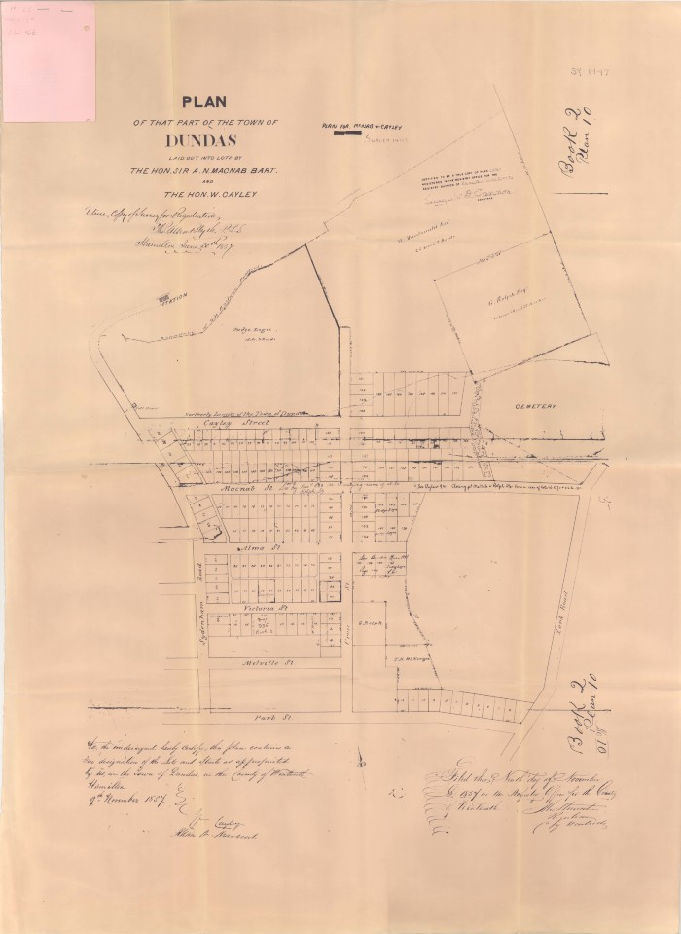
Map (M-0025)
Plan of that Part of the Town of Dundas Laid into Lots by the Hon. Sir A.N. MacNab and the Hon. W. Cayley

Slide 18
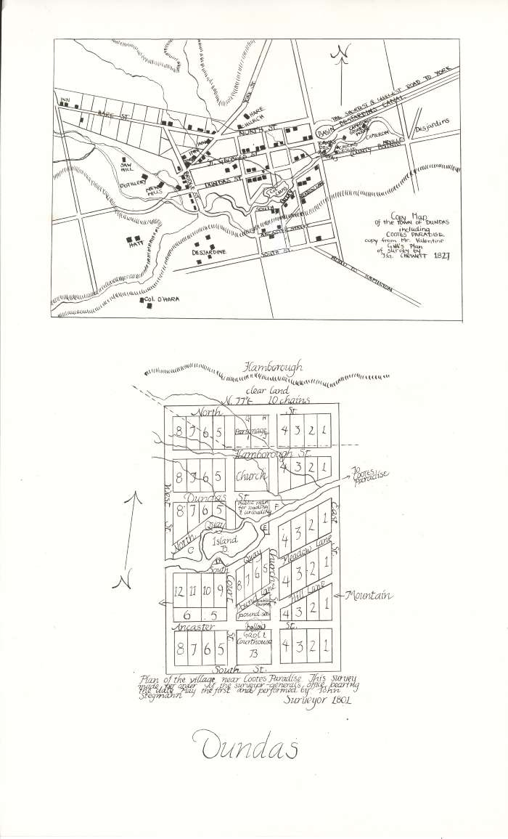
Map (M-0027A)
Copy Map of the Town of Dundas including Coote's Paradise

Slide 19
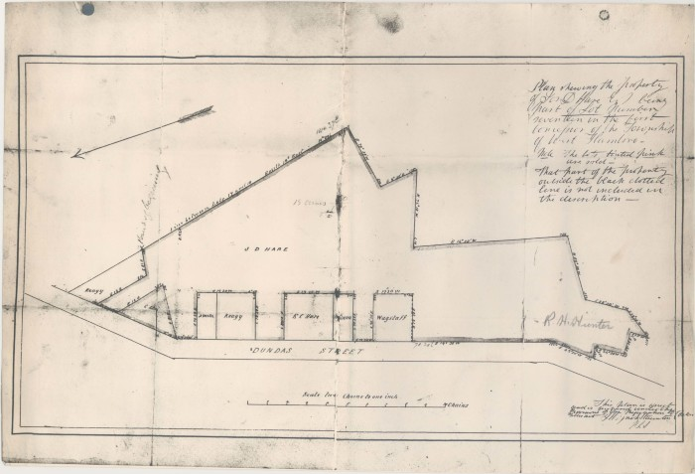
Map (M-0028)
Plan Showing the Property of J.D. Hare, Being Part of Lot Number Seventeen in the First Concession of the Township of West Flamboro

Slide 20
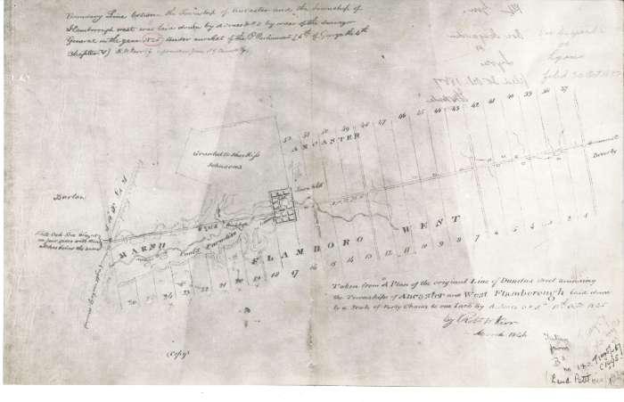
Map (M-0029)
Taken from a Plan of the Original Line of Dundas Street Rounding the Townships of Ancaster and West Flamborough...By A. Jones DPS, 18th Oct. 1825

Slide 21
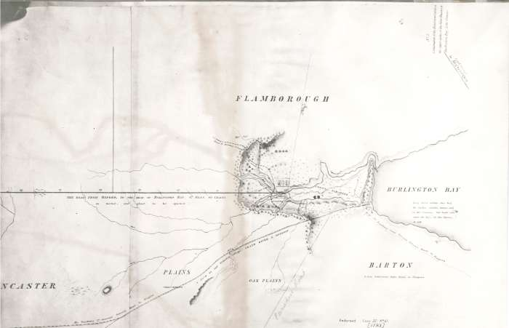
Map (M-0030)
Continuation of the Road from Oxford on the Upper Forks of the River Thames to Burlington Bay, Lake Ontario

Slide 22
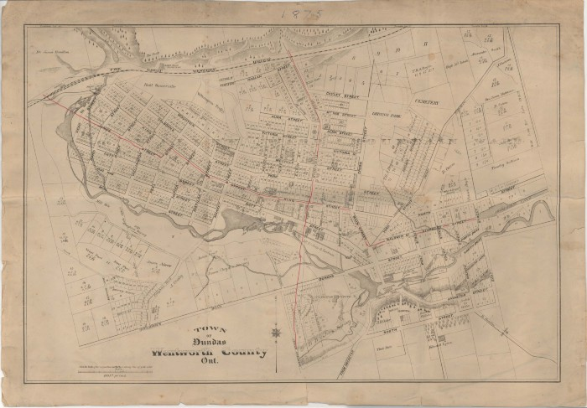
Map (M-0032)
Town of Dundas, Wentworth County, Ont.

Slide 23
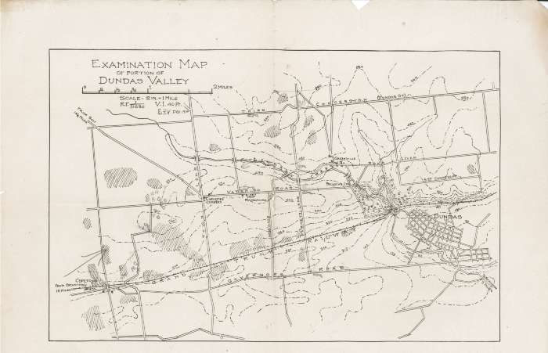
Map (M-0034)
Examination Map of Portion of Dundas Valley

Slide 24
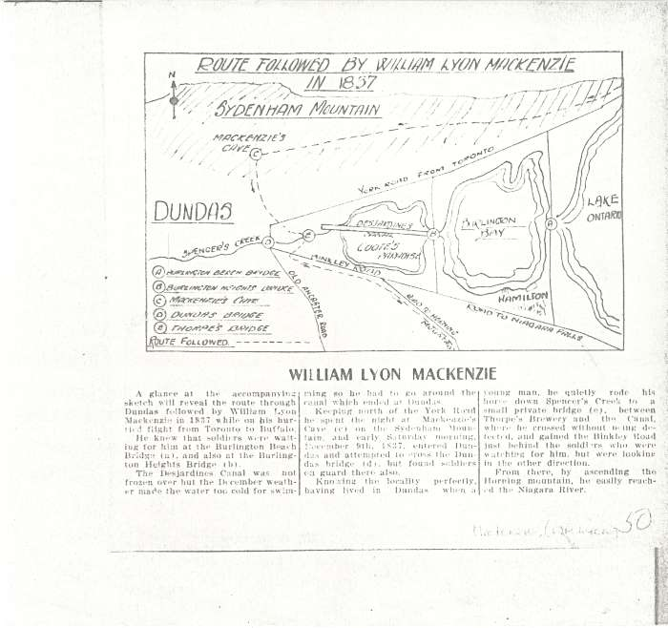
Map (M-0035)
Route Followed by William Lyon Mackenzie in 1837

Slide 25
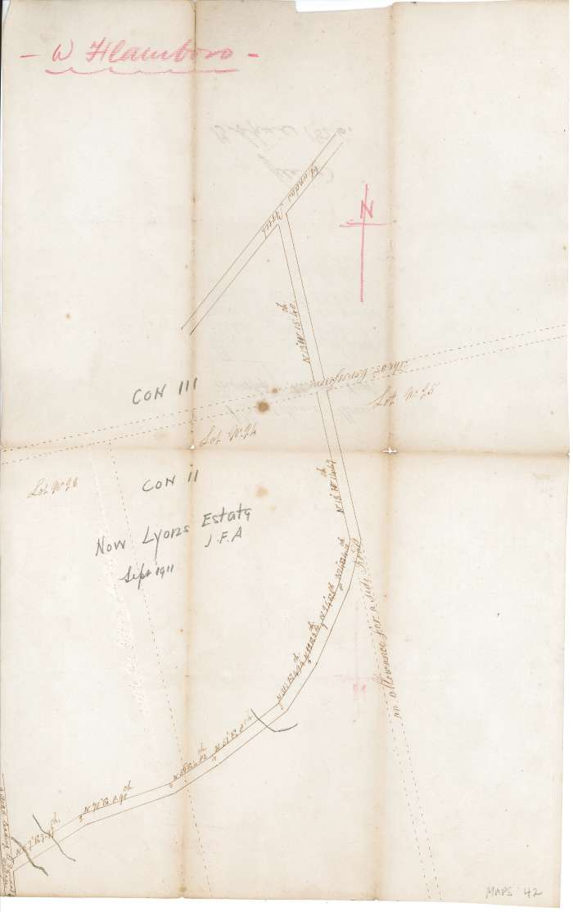
Map (M-0042)
Plan of Second Road, Township of Flamboro West

Slide 26
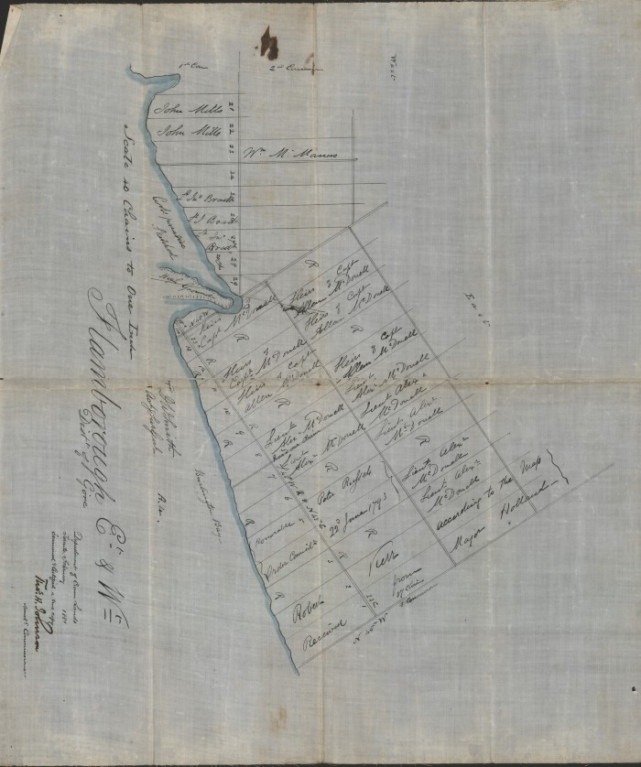
Map (M-0046)
Flamborough East and West, District of Gore

Slide 27
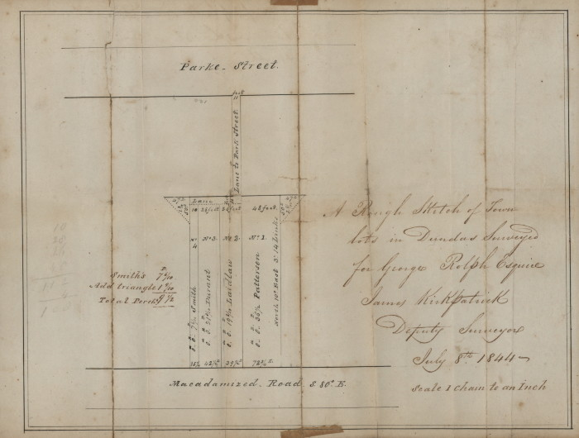
Map (M-0054)
A Rough Sketch of Town Lots in Dundas Surveyed for George Rolph Esquire, James Kirkpatrick Deputy Surveyor, July 8th 1844

Slide 28
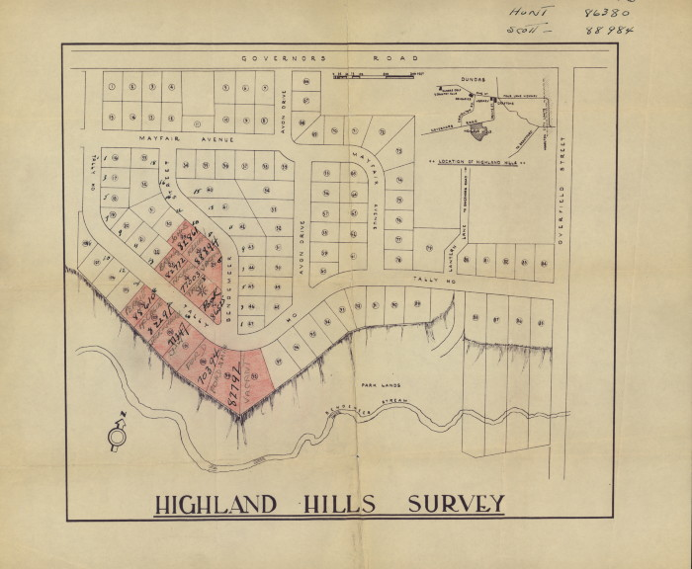
Map (M-0060)
Highland Hills Survey

Slide 29
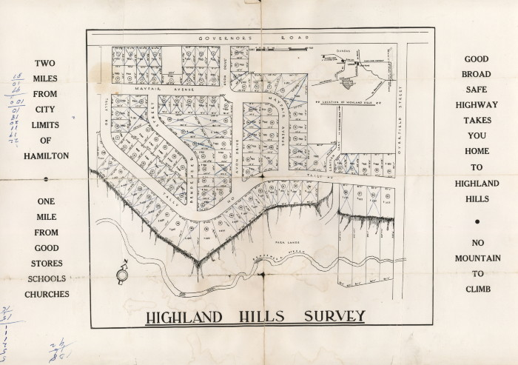
Map (M-0061)
Highland Hills Survey

Slide 30
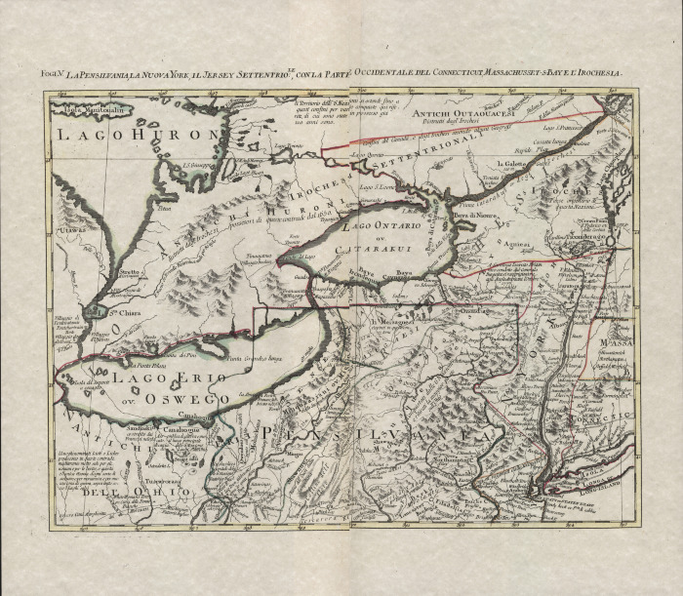
Map (M-0063)
La Pensilvania, La Nuova York, Il Jersey Settentrio: Con la Parte Occidentale del Conneticut, Massachusset - S Bay E L'Irochesia

Slide 31
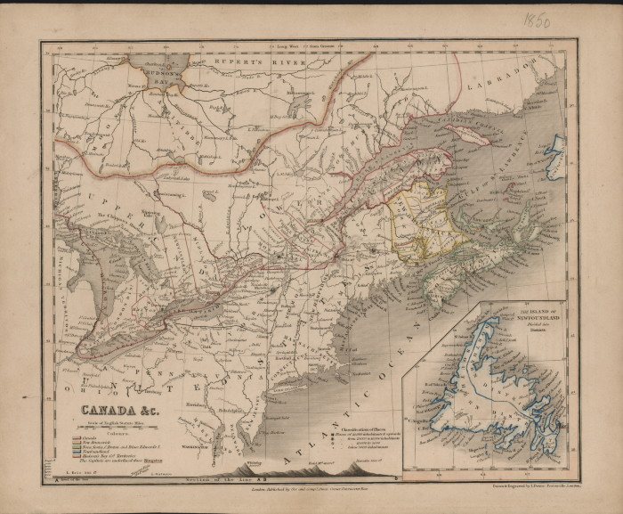
Map (M-0064)
CANADA & c.

Slide 32
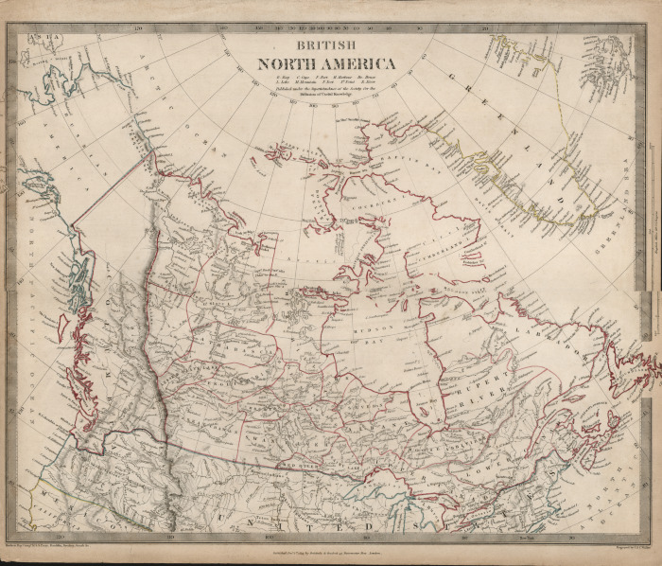
Map (M-0065)
British North America

Slide 33
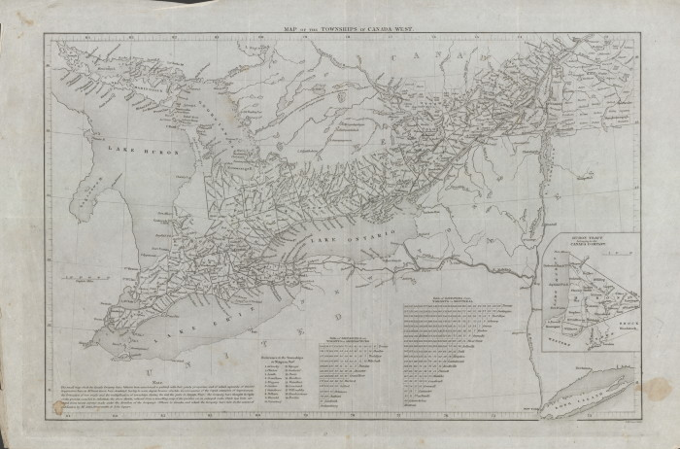
Map (M-0066)
Map of the Townships in Canada West

Slide 34
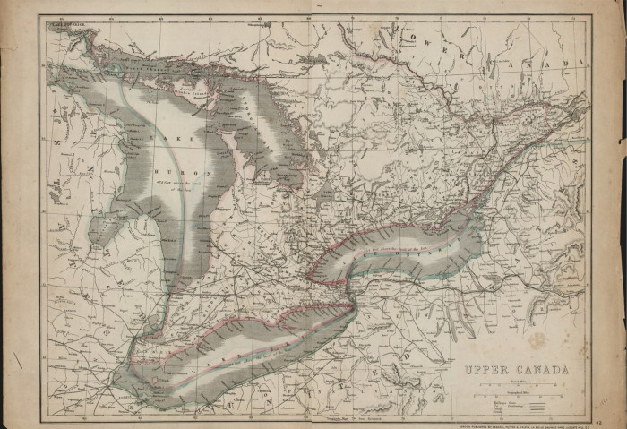
Map (M-0067)
Upper Canada

Slide 35
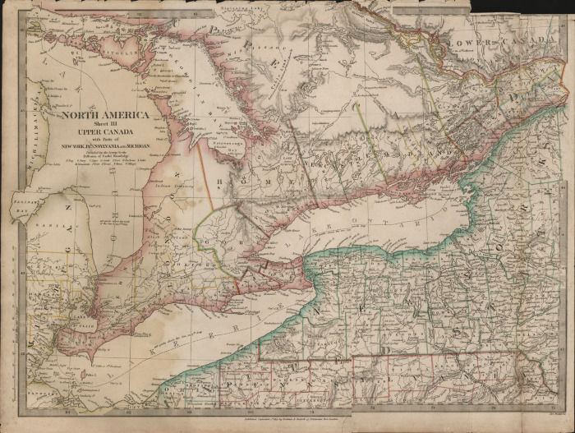
Map (M-0068)
Upper Canada with Parts of New York, Pennsylvania, and Michigan

Slide 36
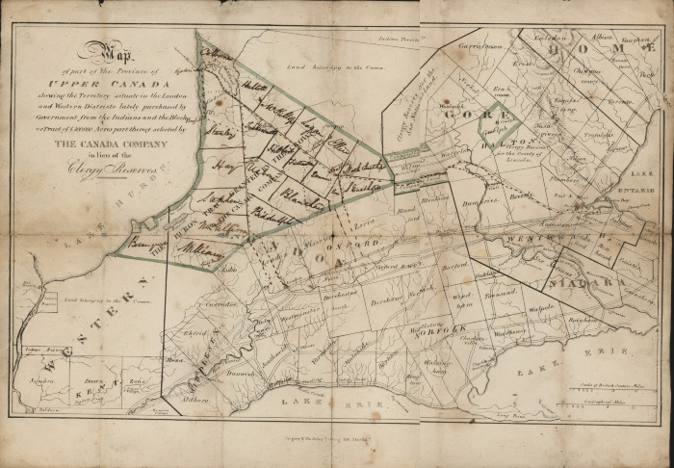
Map (M-0069)
Map of Part of the Province of Upper Canada Showing the Territory Situate in the London and Western Districts Lately Purchased by the Government...

Slide 37
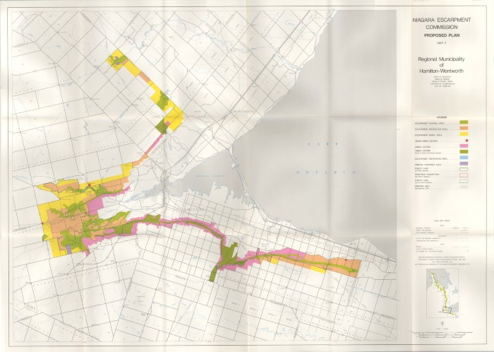
Map (M-0070)
Niagara Escarpment Commission. Proposed Plan. Map 2.

Slide 38
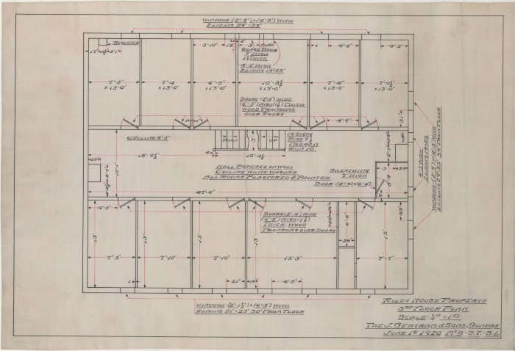
Architectural drawing (M-0072)
Riley House Property 3rd Floor Plan

Slide 39
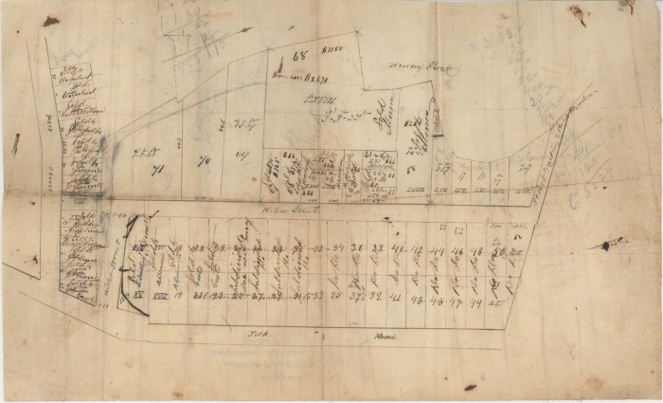
Map (M-0073)
Proposed subdivision of Willett and Helen Streets

Slide 40
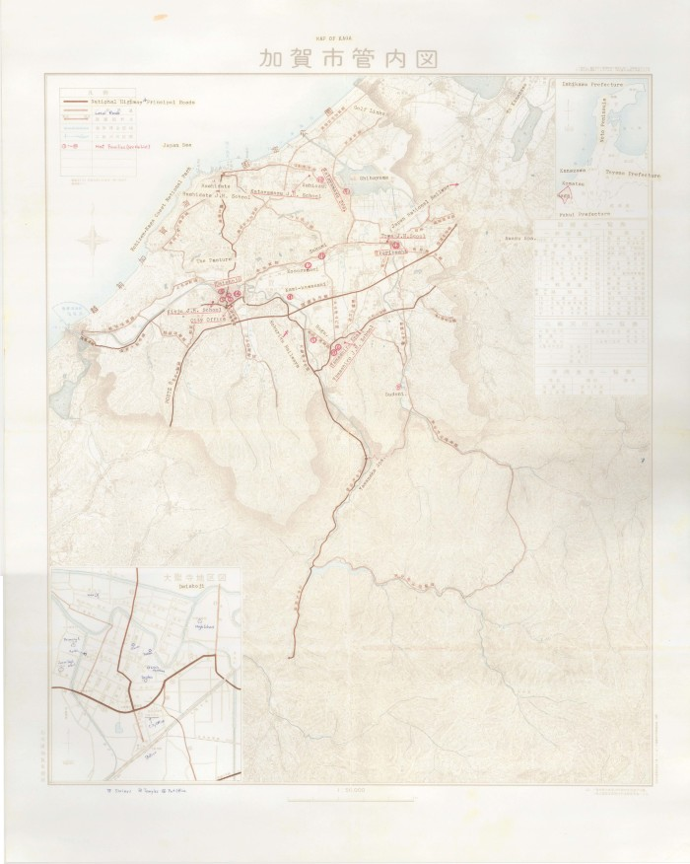
Map (M-0084)
Map of Kaga

Slide 41
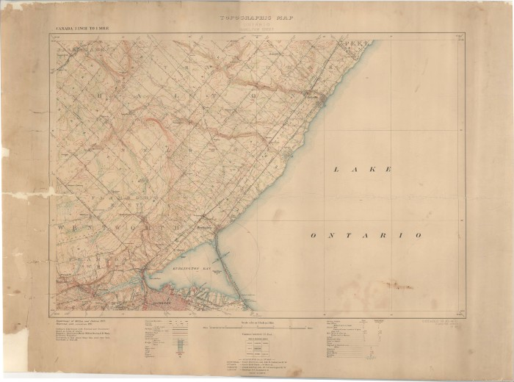
Map (M-0085)
Topographic Map of Ontario: Hamilton Sheet

Slide 42
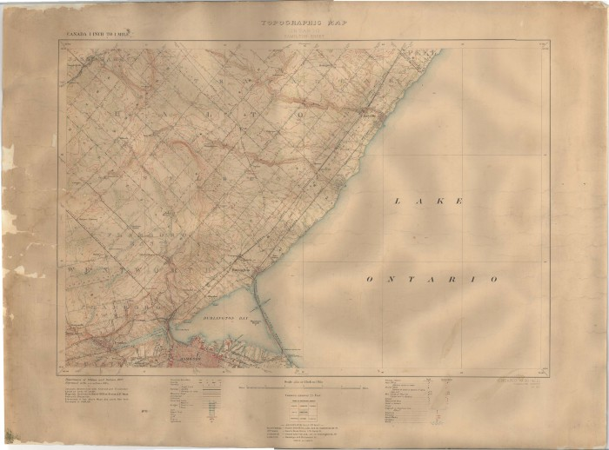
Map (M-0088)
Topographical Map of Hamilton and Dundas

Slide 43
Plan (M-0090)
Plan of the Pleasant Valley subdivision

Slide 44
Plan (M-0091)
Plan of the Pleasant Valley Subdivision

