Slide 1
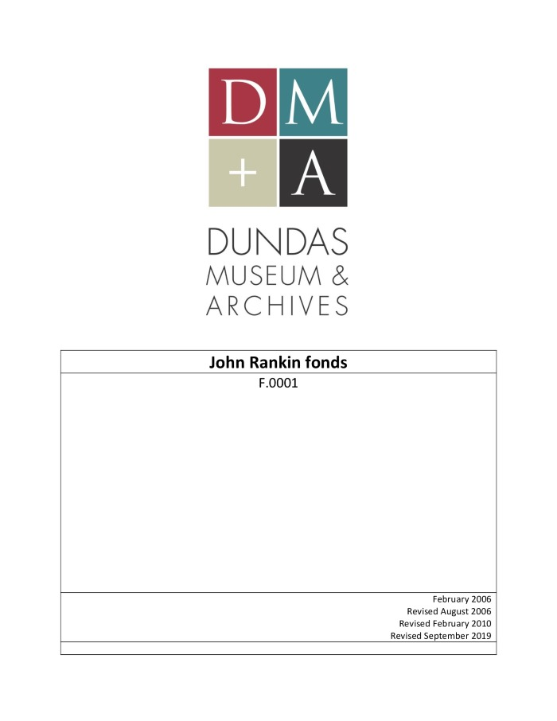
John Rankin fonds (F.0001)
Fonds consists mainly of the diaries and letterbooks of John Rankin which describe his life and work in Scotland and Canada.

Slide 2
Desjardins Canal Company fonds (F.0002)
The fonds consists of correspondence to and from the Desjardins Canal Company directors and staff regarding the operation and management of the Company and the canal. The fonds also includes legal documents, receipts, reports, and notices.

Slide 3
Imperial Order Daughters of the Empire. General McNaughton Chapter fonds (F.0003)
Fonds consists of minute books and scrapbooks which detail the activities of the General McNaughton Chapter of the IODE.

Slide 4
Royal Templars of Temperance. Victoria Council No. 7 (Dundas, Ont.) fonds (F.0004)
The fonds consists of three minute books. The minutes describe the officers, the conduct of the meetings, financial transactions, and the activities of the group.

Slide 5
YMCA Dundas fonds (F.0005)
The fonds consists of minutes; reports including annual reports and committee reports; financial records including an account book, statements of receipt and expenditure, and budgets; correspondence; and a membership book.

Slide 6
Dundas Centennial (1947) Committee fonds (F.0006)
Fonds consists of administrative records related to the organization of centennial events and celebrations; records of committees and events; and photographs.

Slide 7
James Lesslie fonds (F.0007)
Fonds consists of diaries, a memorandum book, and a memorial card.

Slide 8
Lesslie family fonds (F.0008)
The fonds consists of correspondence, diaries, wills, memo books, scrapbooks, memoirs, certificates, bibles, books, property and financial records, and photographs documenting the Lesslie family members’ personal, professional, and political lives in Dundas, Toronto, and outside of Canada.

Slide 9
Ellen Osler Memorial Home fonds (F.0009)
Fonds consists of the charter of the Ellen Osler Memorial Home, inventory book, financial records, correspondence with the government of Ontario, and minutes of meetings.

Slide 10
Hon. Thomas Bain fonds (F.0010)
Fonds consists of records related to the personal and business life of Thomas Bain, as well as his political career.

Slide 11
John Bertram fonds (F.0011)
The fonds consists primarily of John Bertram's personal correspondence with friends and family along with some of his business and legal documents.

Slide 12
Sir Alexander Bertram fonds (F.0012)
The fonds consists mainly of Alexander Bertram’s correspondence, military records, Shell Committee documents, and records relating to Sir Alexander Bertram's command of the 1909 Canadian Bisley team.

Slide 13
Henry Bertram fonds (F.0013)
The fonds consists of the private records of Henry Bertram; the documents are primarily his personal correspondence and research into the Bertram family history. There are also a few of Henry Bertram's financial records in the fonds as well.

Slide 14
Thomas Aimers Bertram Fonds (F.0014)
The fonds consists of the personal records of Thomas Aimers Bertram, being primarily composed of awards/diplomas, records relating to Bisley, correspondence (primarily with his son and a few other singular letters), photographs, newspaper clippings, poetry and some records from his sons military service and death.

Slide 15
Henry Graham Bertram fonds (F.0015)
The fonds consists primarily of Graham Bertram's personal records and correspondence dealing with family and the numerous community positions he held.

Slide 16
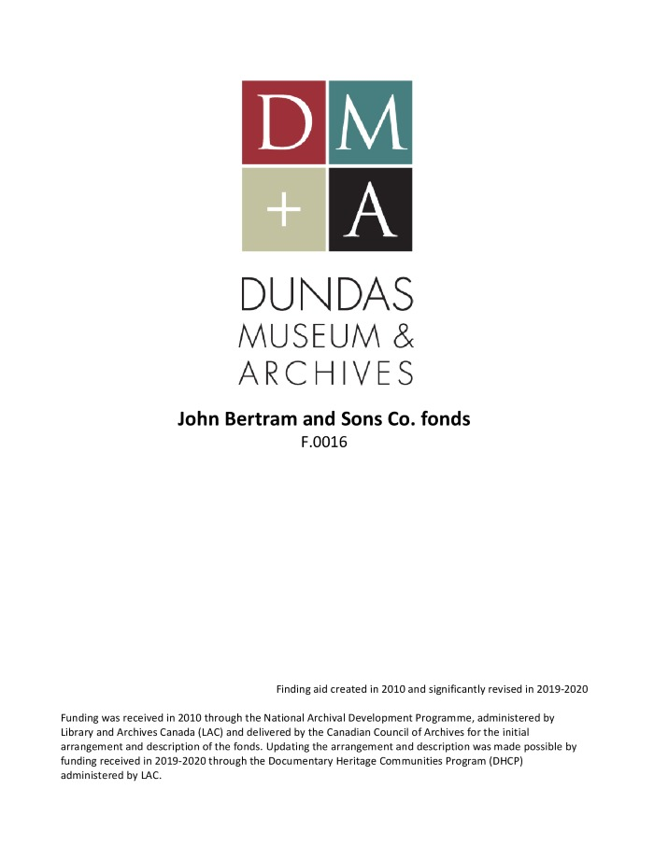
The John Bertram & Sons Co. fonds (F.0016)
The fonds contains records created by The John Bertram & Sons Company along with some of the records of its predecessors including McKechnie & Bertram. It also contains records received by or about John Bertram & Sons that were created by others, including publications and material added by Bertram family members.

Slide 17
Cora Tunis fonds (F.0017)
The fonds consists of diaries, fashion magazines, ration booklets, autograph book, miscellaneous documents, recipes, remedies, note books, and cards.

Slide 18
The Pierian Club (Dundas, Ont.) fonds (F.0018)
The fonds consists of membership handbooks, receipts, a list of membership fees paid, a calendar of 1904 with corrections, and a minute book.

Slide 19
Thomas Head fonds (F.0019)
Fonds consists of Patent of Invention and diagram from 1874 and Letters Patent (US) dated 1875 regarding Thomas Head's invention, the Head's Potato Digger.

Slide 20
Dundas Choral Society fonds (F.0020)

Slide 21
George Robertson Davidson fonds (F.0022)
Fonds consists of three journals written by George Robertson Davidson and one class record from the Wesleyan-Methodist Church.

Slide 22
Dundas Local Architectural Conservation Advisory Committee (LACAC) fonds (F.0024)
The fonds consists of documents and correspondence sent, created and received by Dundas LACAC committee members

Slide 23
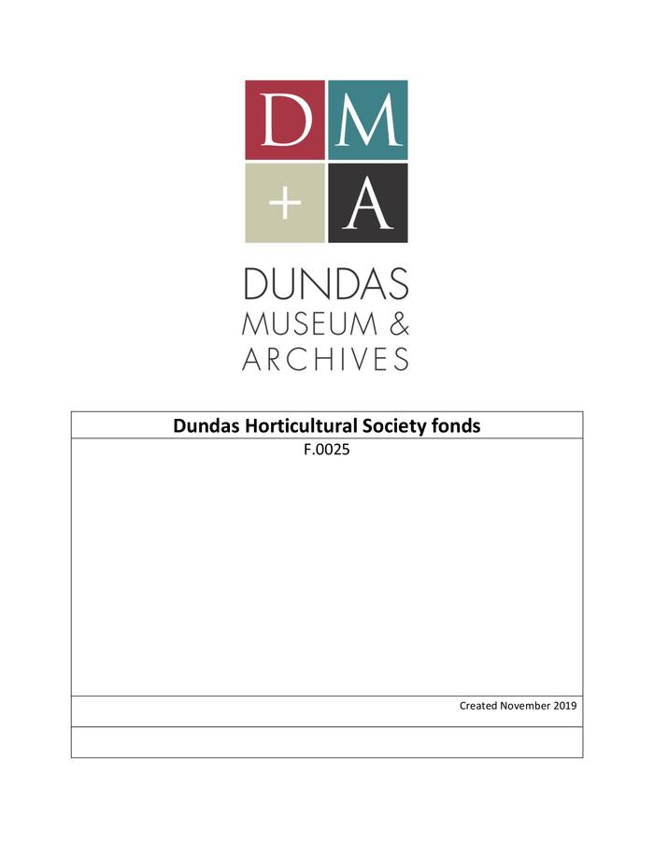
Dundas Horticultural Society fonds (F.0025)
The fonds consists of a wide range of records related to the Dundas Horticultural Society.

Slide 24
Garden Club of Dundas fonds (F.0026)

Slide 25
Calder Grain Shocker Co. fonds (F.0027)

Slide 26
Lawrence Yanover fonds (F.0028)

Slide 27
Probus Club fonds (F.0029)

Slide 28
H.C. Holmes fonds (F.0030)

Slide 29
Florence Grightmire fonds (F.0031)

Slide 30
Edward Ostrosser fonds (F.0032)

Slide 31
Canadian Red Cross Dundas Branch fonds (F.0033)

Slide 32
Dundas Valley Historical Society fonds (F.0034)

Slide 33
Association of Dundas Churches fonds (F.0035)

Slide 34
Ness Family fonds (F.0036)
Documents pertaining to the Ness Family.

Slide 35
Dundas Curling and Skating Club fonds (F.0037)

Slide 36
Pro Bono Club fonds (F.0038)

Slide 37
Charles Spalding fonds (F.0039)

Slide 38
Baker Family fonds (F.0040)

Slide 39
Dundas Travel Club fonds (F.0041)

Slide 40
Nellie Hogarth Foster fonds (F.0042)

Slide 41
Dundas Art and Craft Association fonds (F.0043)

Slide 42
Adam Clark Ltd. fonds (F.0044)

Slide 43
Confederation Diamond Jubilee Celebration Committee fonds (F.0045)

Slide 44
Mary R. Pirie fonds (F.0046)

Slide 45
Dundas Association Football Club fonds (F.0047)

Slide 46
Dundas Bowling Club fonds (F.0048)

Slide 47
C.O.O.F., Dundas Lodge fonds (aka I.O.O.F.) (F.0049)

Slide 48
I.O.G.T., Loyal Canadian Lodge No. 563 (Dundas) (F.0050)

Slide 49
House of Providence picnic fonds (F.0051)

Slide 50
Lt-Col. E.S. Sawell fonds (F.0052)

Slide 51
Horace Aylwin fonds (F.0053)
The fonds consists of photographs, invitations, clippings (copies), postcards, and programmes related to Horace Aylwin’s 1924 appearance at the Paris Olympic Games.

Slide 52
Copetown Women’s Institute fonds (F.0054)
The fonds consist of records related to the operations of the Copetown Women’s Institute.

Slide 53
Primrose Rebekah Lodge No. 59 fonds (F.0055)

Slide 54
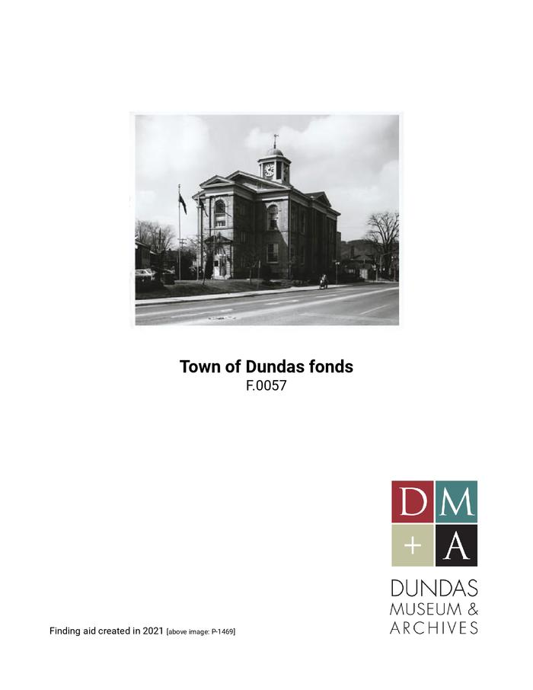
Town of Dundas fonds (F.0057)
Records created or received and maintained by the former Town of Dundas, prior to amalgamation with the City of Hamilton. The records are predominantly related to properties and property taxation, as well as Town Council meetings, birth, marriage, and death related records, and some Town organizations and celebrations.

Slide 55
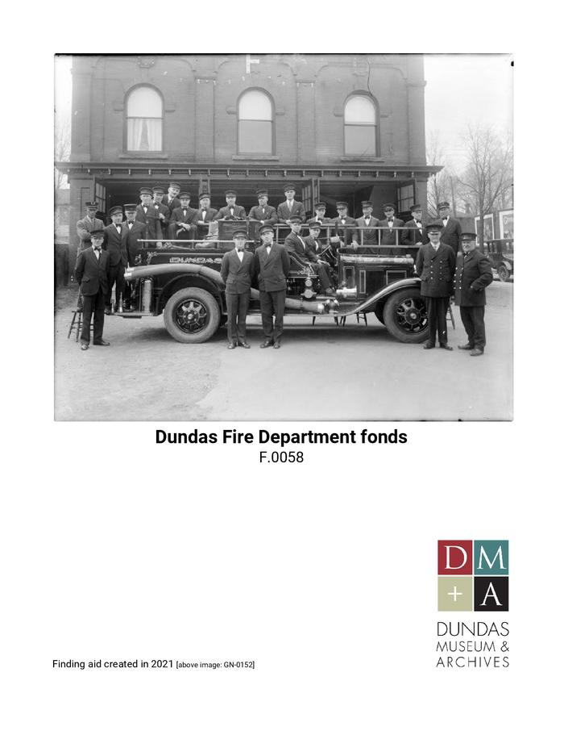
Dundas Fire Department fonds (F.0058)
The fonds consists of records created by or about the Dundas Fire Department

