Slide 1
Walker Schofield Collection (C.0001)

Slide 2
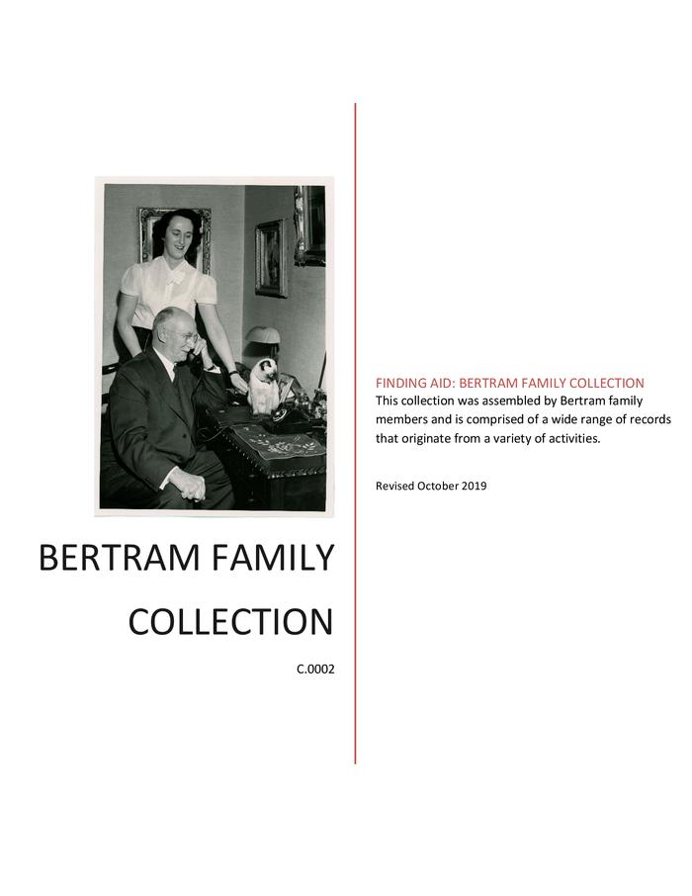
Bertram Family Collection (C.0002)
The collection is comprised of a wide range of records relating to the Bertram family.

Slide 3
Dr. James Ross Collection (C.0003)
Collection consists of one box with documents relating to Dr. James Ross.

Slide 4
Mark Young Stark family papers (C.0004)
Most of the records consist of letters written to Mark Young Stark and his wife, Agatha, in Dundas. Correspondents include friends and family in Scotland or friends and colleagues in Upper Canada. Of the Scottish letters, those from Stark’s stepmother (Mary Bannatyne) and aunt (Grace Young) are the most numerous. Some letters predate Stark’s immigration to Canada in 1833. Other letters were written to his wife and to their daughter, Mary Ann, after Stark’s death in 1866. Topics addressed in the letters revolve around personal and family news but occasionally touch on current events, including politics and ecclesiastical affairs.

Slide 5
Stark Family papers (C.0004)
Collection consists primarily of correspondence.

Slide 6
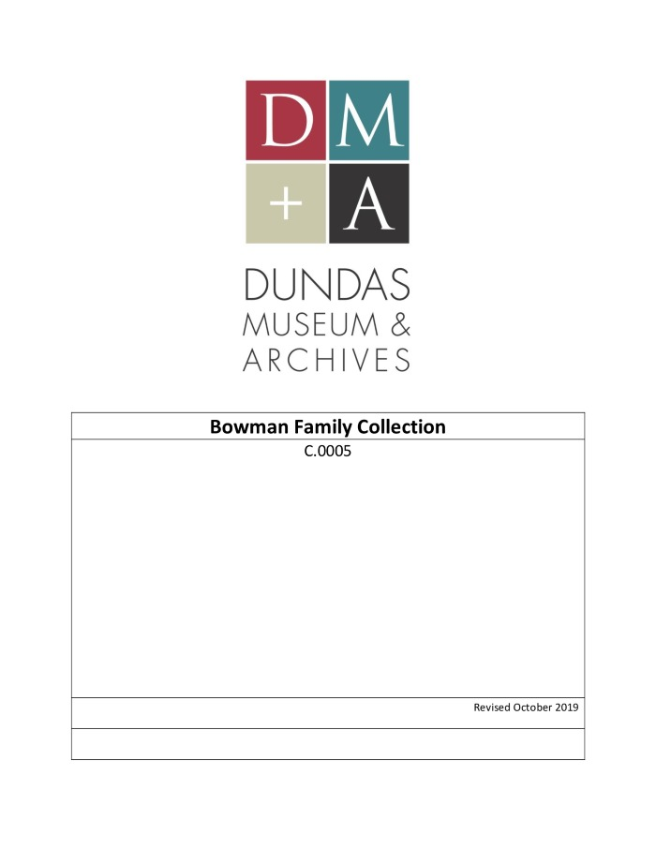
Bowman Family Collection (C.0005)
This collection consists of assorted documents, clippings, a time book, correspondence, tickets, and other ephemera related to the Bowman family. The collection includes an essay “Tentative Bowman Family Tree” by T. Roy Woodhouse in 1961.

Slide 7
Dundas Schools Collection (C.0006)
Collection consists of one box with documents relating to the Dundas Schools. Five volumes of Board of Education minutes as well as financial and student related records have been added to this collection.

Slide 8
Middleton Collection (C.0007)
Collection consists of one box with documents relating to research on J.W. Spencer

Slide 9
Frank Westoby Collection (C.0008)
Collection consists of six boxes with documents relating to the professional and personal life of Frank Westoby.

Slide 10
Allan F. Stewart Collection (C.0009)
Collection consists of one box of material relating to the professional life of Allan F. Stewart.

Slide 11
Dundas Fire Department Collection (C.0010)
Collection consists of one box with documents relating to the Dundas Fire Department, including a folder of photographic images. It also includes 7 volumes of minute books, scrapbooks, and records of fires.

Slide 12
Stock Family collection (C.0011)

Slide 13
St. Paul’s United Church collection (C.0012)

Slide 14
Tunis Family collection (C.0013)

Slide 15
Chandler Bennitt collection (C.0014)
This collection consists of thirty-two black and white photographic prints showing floats, bands, and other entries in the Dundas Centennial Parade. The parade took place on Tuesday, July 1, 1947. It began at the Dundas High School on King Street and finished at the Dundas Driving Park.

Slide 16
Anderson Family collection (C.0015)

Slide 17
Miriam Flatt collection (C.0016)

Slide 18
Norah Brown Lusitania collection (C.0017)

Slide 19
Benjamin Kirk collection (C.0018)

Slide 20
Karen Carpenter collection (C.0019)

Slide 21
Eden Family collection (C.0020)

Slide 22
Kingdon collection (C.0022)

Slide 23
76 Alma Street collection (C.0023)
The collection consists of 16 documents related to 76 Alma Street.

Slide 24
Donkin collection (C.0024)

Slide 25
Government collection (Regional Sewage System) (C.0025)

Slide 26
Card collection (C.0026)

Slide 27
Picturesque Dundas collection (C.0027)

Slide 28
Wong Estate collection (C.0029)

Slide 29
County of Wentworth collection (C.0030)

Slide 30
Notman Family collection (C.0031)
The collection consists mainly of military commissions of William Notman, letters, invitations, and clippings. There is also the Will of George Notman and other documents related to him.

Slide 31
Military Collection (C.0032)

Slide 32
Laing Family collection (C.0033)

Slide 33
Pat O’Hara collection (C.0034)

Slide 34
Sheehan Family collection (C.0035)

Slide 35
William Lyon Mackenzie collection (C.0036)

Slide 36
Lennie Collection (C.0037)

Slide 37
Anne Redish Collection (C.0038)

Slide 38
Borer Family Collection (C.0039)

Slide 39
Mary Shaw Sketch Collection (C.0040)

Slide 40
Dundas Little Theatre Collection (C.0041)

Slide 41
Sadie MacBride Collection (C.0042)

Slide 42
Gillis Collection (C.0043)

Slide 43
Helen Candlish Collection (C.0044)

Slide 44
Abbey Collection (C.0045)
photographic postcards

Slide 45
Dorothy Dring Collection (C.0046)
photographs

Slide 46
J. David Richardson Collection (C.0047)

Slide 47
Fleming Collection (C.0048)

Slide 48
Philp Collection (C.0049)

Slide 49
Sutton and Kirk Collection (C.0050)
The collection contains records related to the Sutton and Kirk families.

Slide 50
Crooks Family Collection (C.0051)

Slide 51
T.H. McKenzie and Family Collection (C.0052)

Slide 52
Terryberry Family Collection (C.0053)
The fonds consists of letters, postcards, newspaper clippings, family tree’s, bibles, certificates, awards, photo albums, diaries, travelogues, miscellaneous personal documents, books, photographs, genealogy notes, financial ledgers, school reports, and purchase agreements.

Slide 53
Dundas Baptist Church Collection (C.0054)

Slide 54
Dr. Clarence Bates Collection (C.0055)

Slide 55
Dundas Museum Osler Collection (C.0056)

Slide 56
Cookbook Collection (C.0057)
The Cookbook Collection consists of a variety of collected recipes. They include books published for a profit, for a fundraiser or through government decree. They were published to promote a product or were handwritten and form cherished family memories. The books range in date from 1824 to the 1970s and were acquired mainly through donation.

Slide 57
Nina Chapple Collection (C.0058)

Slide 58
R.E. Bertram Collection (C.0059)

Slide 59
Tester Family Collection (C.0060)

Slide 60
Southall Family Collection (C.0061)

Slide 61
Norman T. Finlayson Collection (C.0062)

Slide 62
Janet Bertram Brown Collection (C.0063)

Slide 63
McMaster Collection (C.0064)

Slide 64
Dundas Sports Wall of Fame Collection (C.0065)

Slide 65
Pirie Family Collection (C.0066)
photographs and documents

Slide 66
Doran Collection (C.0067)
Steetley Quarry land use re-designation issue

Slide 67
Harper Family Collection (C.0068)

Slide 68
Neil Matthews Collection (C.0069)

Slide 69
Adriana Romkes Collection (C.0070)

Slide 70
Town of Dundas Collection (C.0071)
Town of Dundas records donated to the Museum separately from the Town of Dundas fonds (F.0057)

Slide 71
Dundas Branch Victorian Order of Nurses Collection (C.0072)

Slide 72
Teresa Smith Collection (C.0073)

Slide 73
J. Findlay Smith Collection (C.0074)

Slide 74
Ray Connell Collection (C.0075)

Slide 75
W.F. Campbell Collection (C.0076)

Slide 76
Builder Family Collection (C.0077)

Slide 77
Cochenour Family Collection (C.0078)

Slide 78
John Burns Collection (C.0079)

Slide 79
Lennard Family Collection (C.0081)

Slide 80
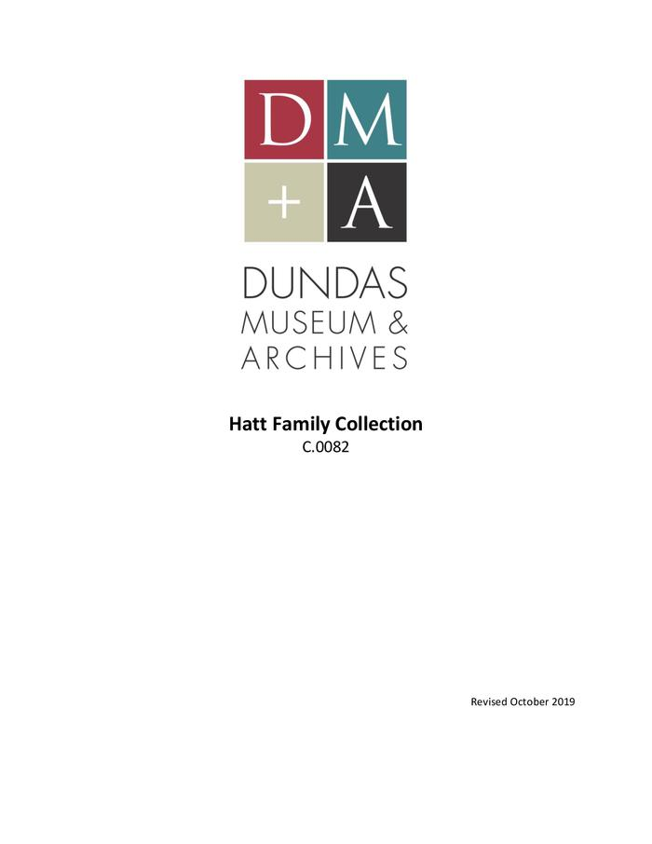
Hatt Family Collection (C.0082)
Collection consists of records acquired during Richard Hatt's life and posthumously.

Slide 81
Mrs. F.I. Galbraith Collection (C.0083)

Slide 82
Meiler Family Collection (C.0084)

Slide 83
Jack Kelly Collection (C.0085)
slides

Slide 84
Gertrude McManamy Collis Collection (C.0086)

Slide 85
Yates’ Town of Dundas Collection (C.0087)
Records of the Town of Dundas compiled by Robert Yates

Slide 86
Discepolo Family Collection (C.0088)

Slide 87
Bertram Randall Collection (C.0089)

Slide 88
Barnes/Pettino Collection (C.0090)

Slide 89
Charles Edward Chanter Collection (C.0091)

Slide 90
Robert Grant Garry Sr Collection (C.0092)

Slide 91
Dundas Museum Railway Collection (C.0093)
material collected by or donated to the Museum related to trains, railways, train station

Slide 92
Bowman/Hils Family Collection (C.0094)

Slide 93
Kreitzler Collection of Bertram/Orenstein & Koppel photographs (C.0095)

Slide 94
Watson Family Collection (C.0096)

Slide 95
Gordon Couldrey Collection (C.0097)

Slide 96
John Don Collection (C.0098)

Slide 97
Ross Family Collection (C.0099)

Slide 98
Dave Cobb/Ravine Bash Collection (C.0100)

Slide 99
Brady Family Collection (C.0101)

Slide 100
Martin Family Collection (C.0102)

Slide 101
Great Western Brewery Collection (C.0103)

Slide 102
Dickson Family Collection (C.0104)

Slide 103
Gore Mills Collection (C.0105)

Slide 104
Dundas Cotton Mills Collection (C.0106)

Slide 105
Chegwin Family Collection (C.0107)

Slide 106
Chapman Engine & Manufacturing Co. Ltd. Collection (C.0108)

Slide 107
Canada Can Company Collection (C.0109)

Slide 108
Greening Wire Works Collection (C.0110)

Slide 109
Dundas Axe Works Collection (C.0111)

Slide 110
Larry Van Sickle Collection (C.0112)

Slide 111
John Forsyth Collection (C.0113)

Slide 112
Andrew Motherwell of Canada Ltd. Collection (C.0114)

Slide 113
Harvey Collection (C.0116)

Slide 114
Barry Mungar Collection (C.0117)

Slide 115
Grace Jamieson Collection (C.0118)

Slide 116
Rockton Collection (C.0119)

Slide 117
Keagey Family Collection (C.0120)

Slide 118
Post Office Collection (C.0121)

Slide 119
Coleman Family Collection (C.0122)

Slide 120
Ferrie Family Collection (C.0123)

Slide 121
Dundas Glass Works Collection (C.0124)

Slide 122
Russ Powers Collection (C.0125)
Booklet - "Kids from Dundas" calendar, 1990 (Kids for Kaga visit itinerary, contact info, host families, etc) Folder - Webster's Falls Bridge Restoration Committee docs, 1999 (minutes, reports, promotional material,etc.) Photographic prints (b&w) of flooding in Dundas, 1946 and 1948 Small booklet - Historic Coronation Souvenir, 1937 (small booklet) Document - Info about Excelsior Refinery postcards by Peter Child Clippings and newsletter re: rail trail Report: HRCA Master Plan for the Development of a Greenway along the former Toronto, Hamilton and Buffalo Railway corridor (Rail Trail) "Forever Dundas" publication

Slide 123
Dundas Odd Fellows Collection (C.0126)

Slide 124
Marty Zuliniak Collection (C.0127)

Slide 125
Gartshore Family Collection (C.0128)

Slide 126
Graham Family Collection (C.0129)

Slide 127
William Graham Family Collection (C.0130)

Slide 128
Gwyn Family Collection (C.0131)

Slide 129
Latshaw Family Collection (C.0132)

Slide 130
Laing Family Collection (C.0133)

Slide 131
McMahon Family Collection (C.0134)

Slide 132
Morden Family Collection (C.0135)

Slide 133
Moss Family Collection (C.0136)

Slide 134
Overfield Family Collection (C.0137)

Slide 135
Quarry, Perry, and Atkinson Family Collection (C.0138)

Slide 136
Simons Family Collection (C.0139)

Slide 137
Stenhouse Family Collection (C.0140)

Slide 138
Sutherland, James Rose Family Collection (C.0141)

Slide 139
Thomas, Samuel Family Collection (C.0142)

Slide 140
Turnbull Family Collection (C.0143)

Slide 141
Weaver Family Collection (C.0144)

Slide 142
Joseph Webster Family Collection (C.0145)

Slide 143
Dr. A.R. Woods Family Collection (C.0146)

Slide 144
Empire Day Collection (C.0147)

Slide 145
Canadian Bank of Commerce Collection (C.0148)

Slide 146
Dr. Charles Roman Collection (C.0149)

Slide 147
Dundas Lions Club Collection (C.0150)

Slide 148
Grafton & Co. Collection (C.0151)

Slide 149
Grafton Family Collection (C.0152)

Slide 150
James Somerville Collection (C.0153)

Slide 151
Ella Arthurs Collection (C.0154)

Slide 152
Collins Hotel Property Collection (C.0155)

Slide 153
Keith Green Collection (C.0156)

Slide 154
Bertram Technical Drawings Collection (Lyons Collection) (C.0157)
Technical drawings for the manufacture of machinery

Slide 155
Whitfield Family Collection (C.0158)
1 scrapbook with loose photograph, clippings, documents (scrapbook is a used assessment roll) 1 family tree with amendments

Slide 156
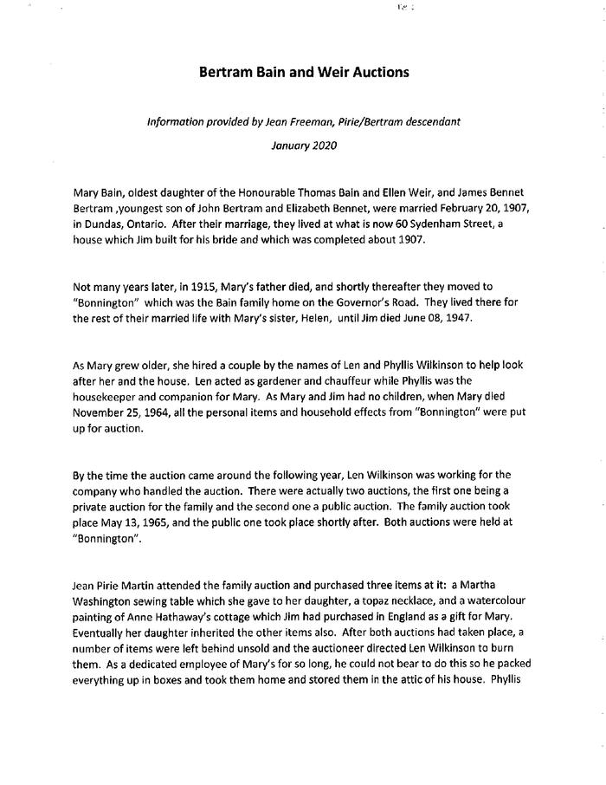
Bertram Photo Negative Collection (Bryden Collection) (C.0159)
Collection consists of glass plate negatives, nitrate negatives, and photographic prints attributed to amateur photographer James Bennet Bertram.

