Slide 1
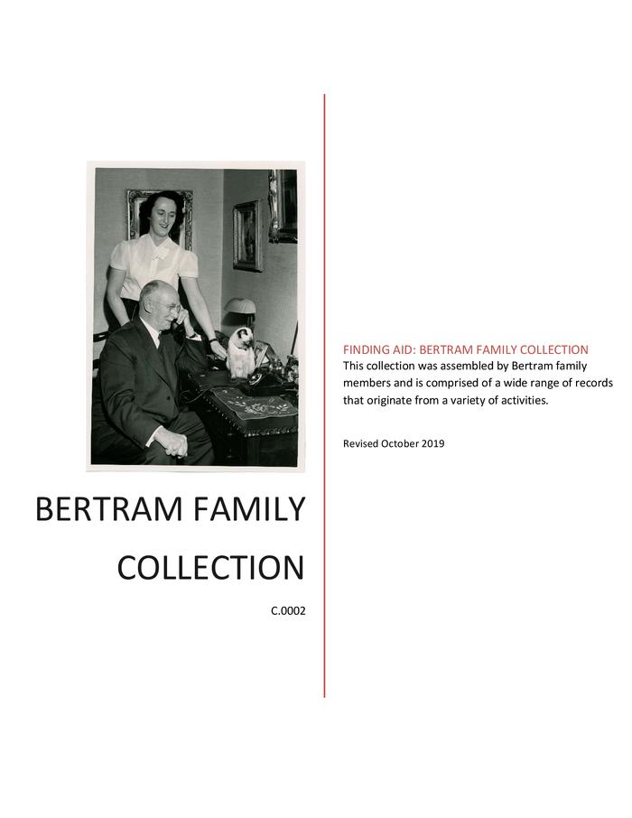
Bertram Family Collection (C.0002)
The collection is comprised of a wide range of records relating to the Bertram family.

Slide 2
Bertram Technical Drawings Collection (Lyons Collection) (C.0157)
Technical drawings for the manufacture of machinery

Slide 3
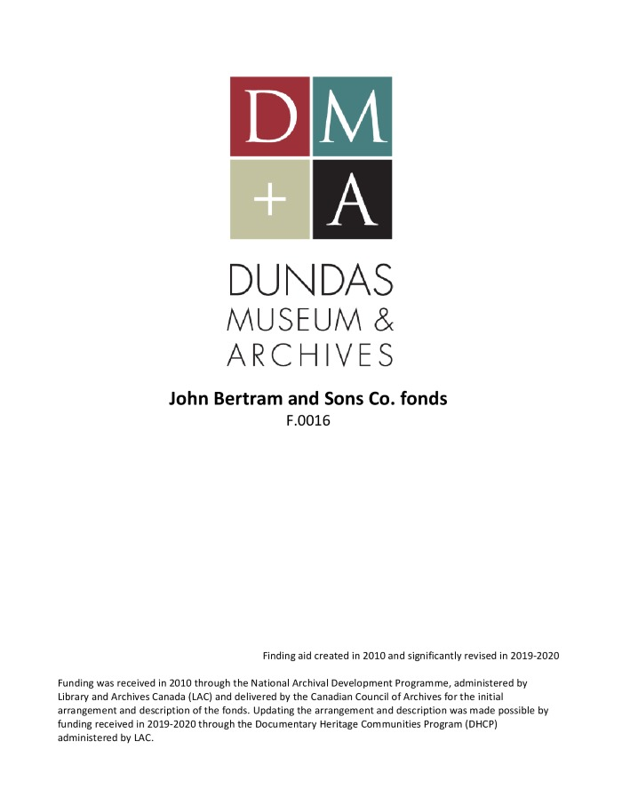
The John Bertram & Sons Co. fonds (F.0016)
The fonds contains records created by The John Bertram & Sons Company along with some of the records of its predecessors including McKechnie & Bertram. It also contains records received by or about John Bertram & Sons that were created by others, including publications and material added by Bertram family members.

