Slide 1
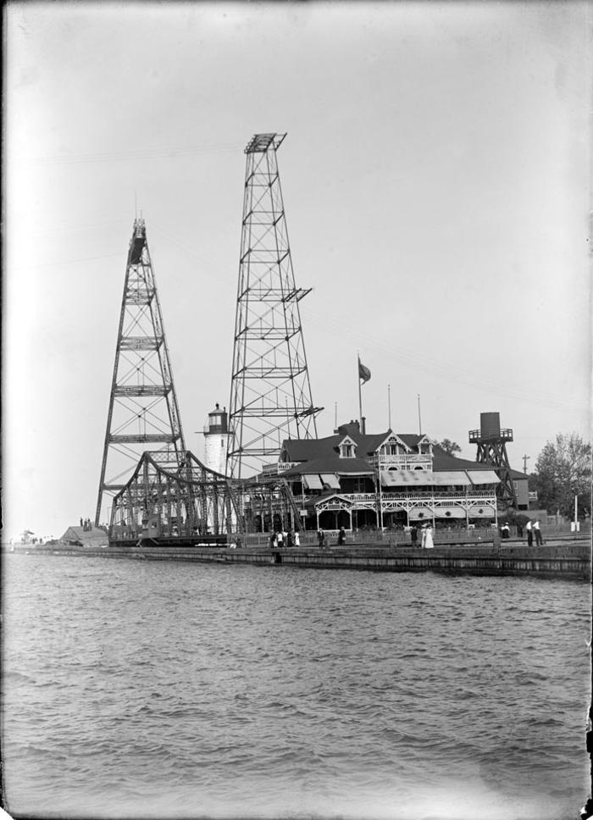
Glass negative (GN-0261)
Lakefront view of towers, building and lighthouse

Slide 2
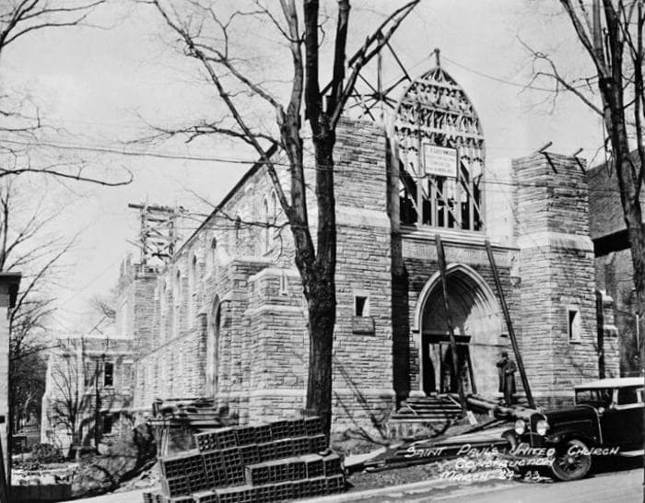
Glass negative (GN-0270)
Re-construction of St. Paul's United Church

Slide 3
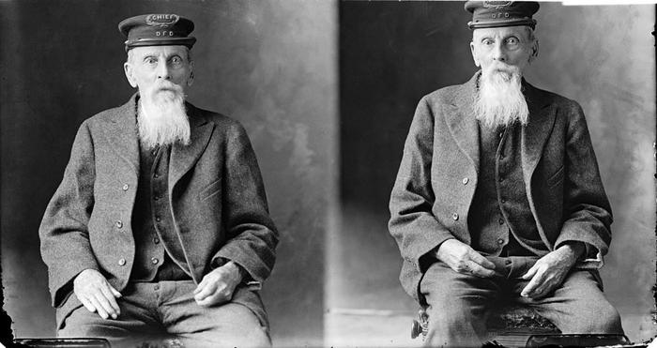
Glass negative (GN-0272)
William Knowles, Chief of the Dundas Fire Department

Slide 4
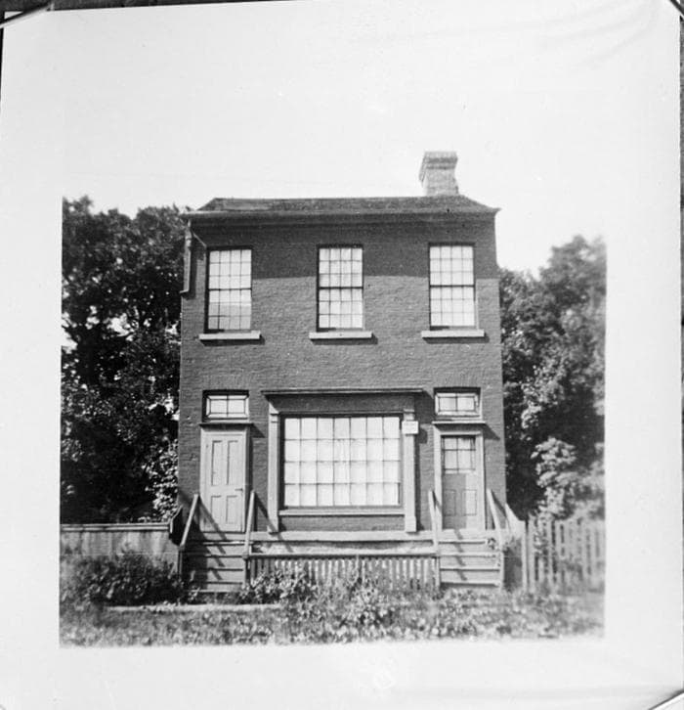
Glass negative (GN-0293)
Bessie Ridler's school on Hatt Street

Slide 5
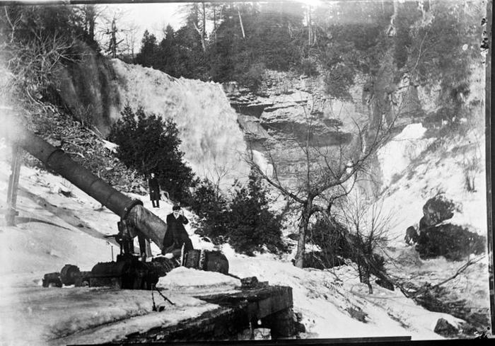
Glass negative (GN-0295)
Remains of the Dundas Electric Light and Power Company operation after the fire of 1901

Slide 6
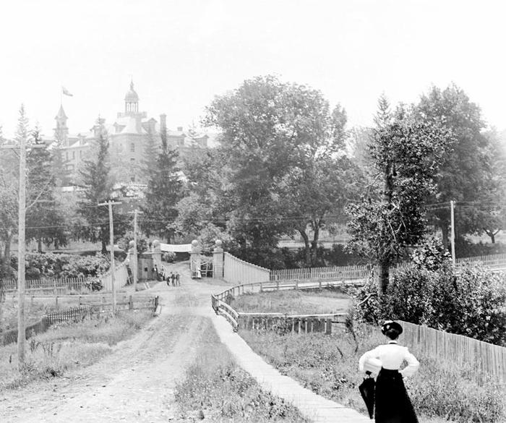
Glass negative (GN-0296)
House of Providence

Slide 7
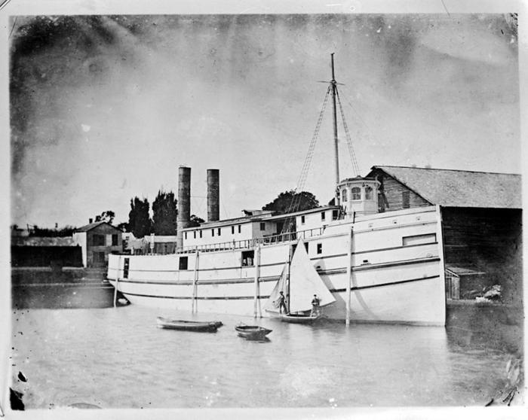
Glass negative (GN-0297)
Boat in the Desjardins Canal Turning Basin

Slide 8
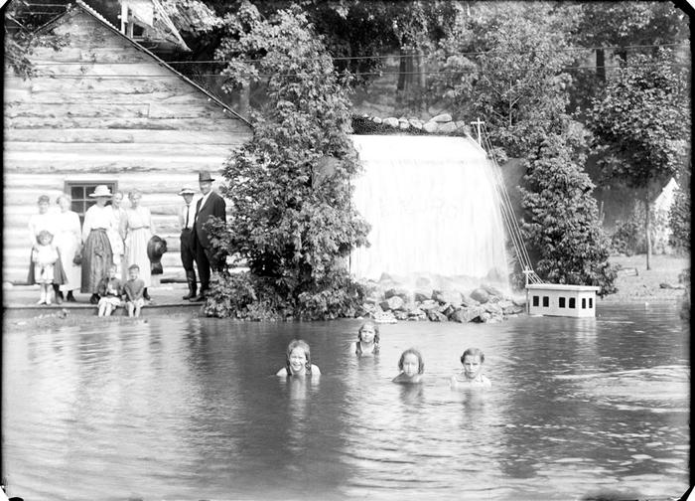
Glass negative (GN-0298)
Children in the wading pool at the Dundas Driving Park

Slide 9
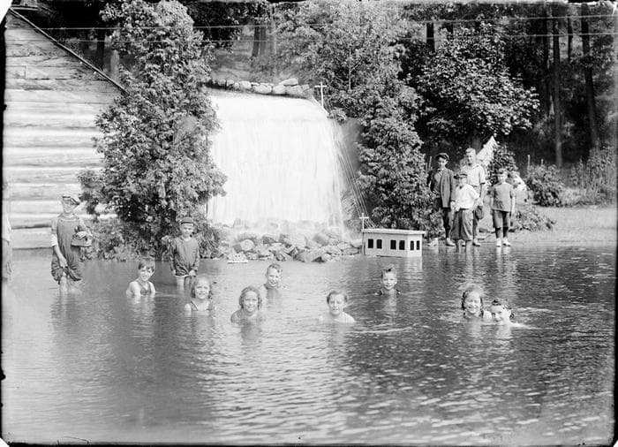
Glass negative (GN-0299)
Children in the wading pool at the Dundas Driving Park

Slide 10
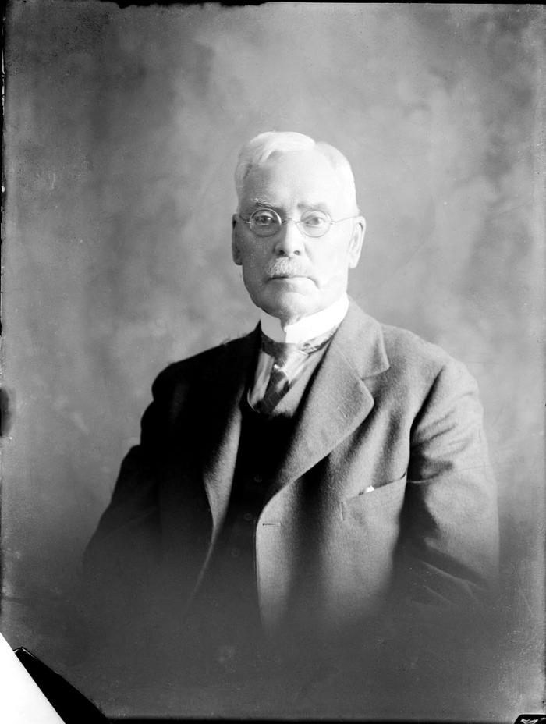
Glass negative (GN-0302)
W.F. Moore

Slide 11
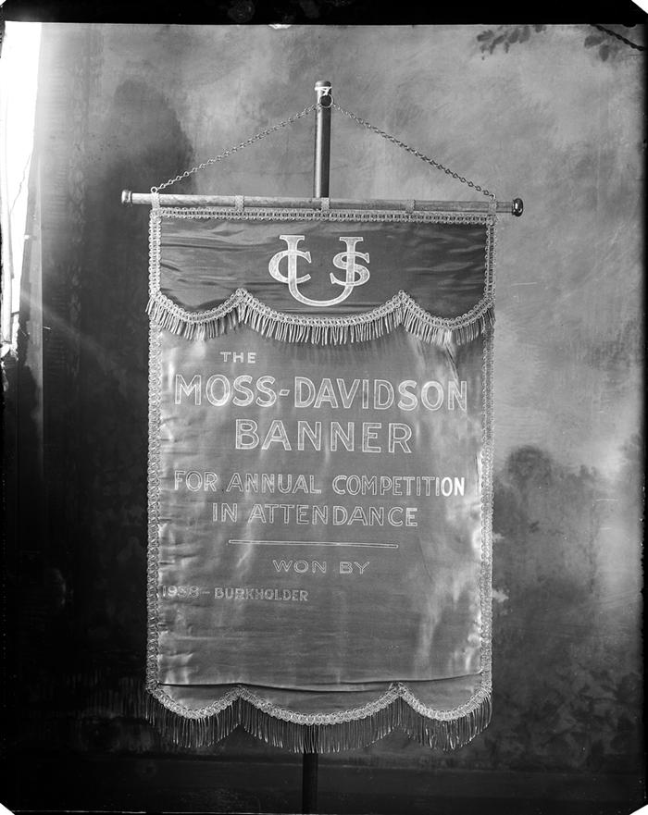
Glass negative (GN-0303)
The Moss Davidson banner

Slide 12
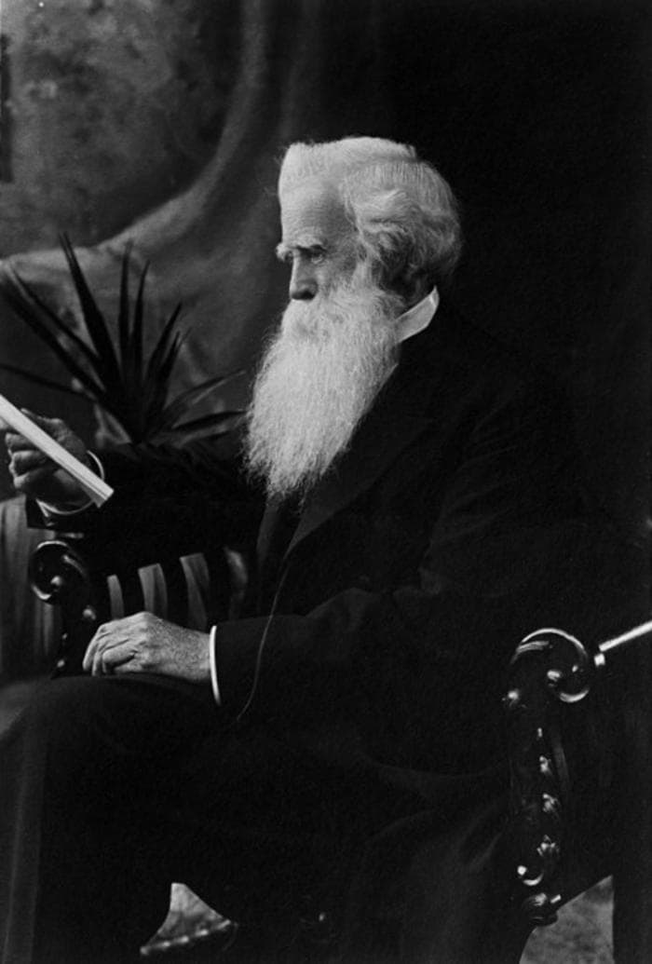
Glass negative (GN-0305)
Unidentified elderly man

Slide 13
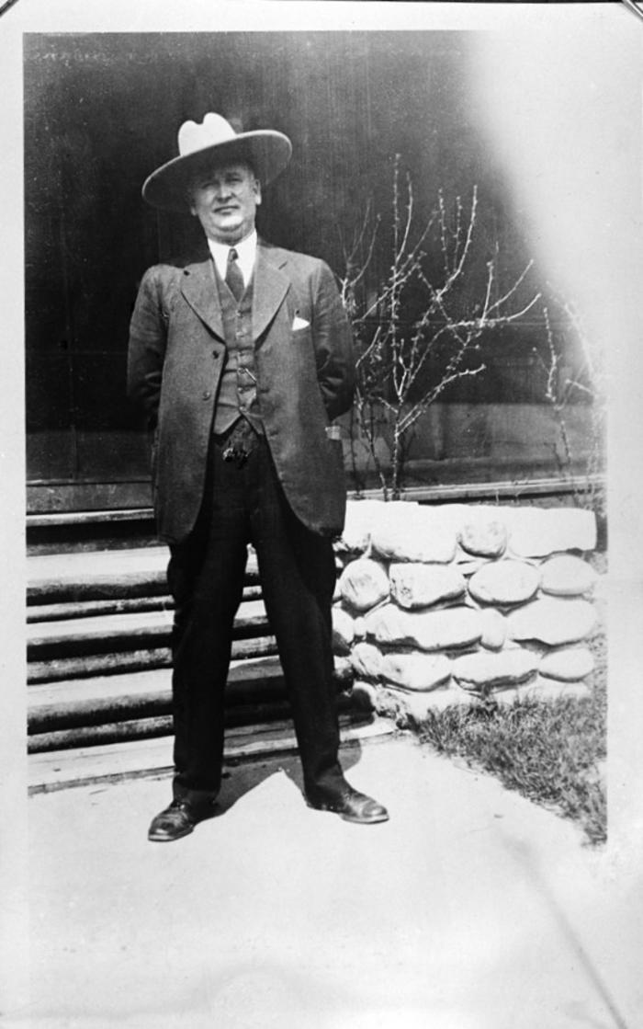
Glass negative (GN-0319)
Thomas W. McDonough

Slide 14
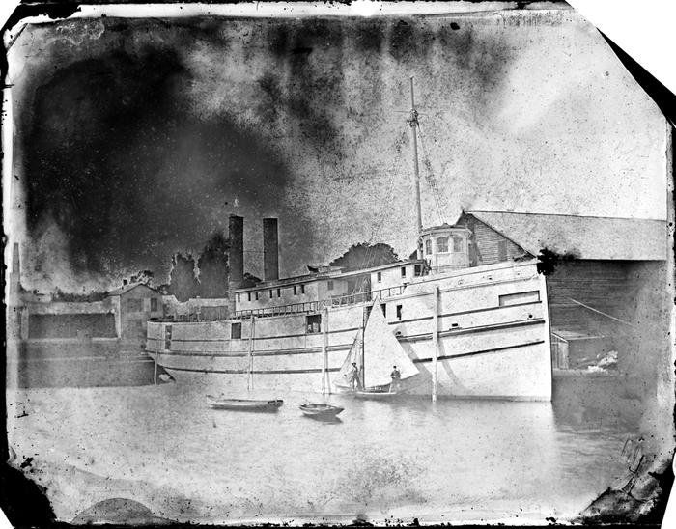
Glass negative (GN-0321)
"The Eclipse"

Slide 15
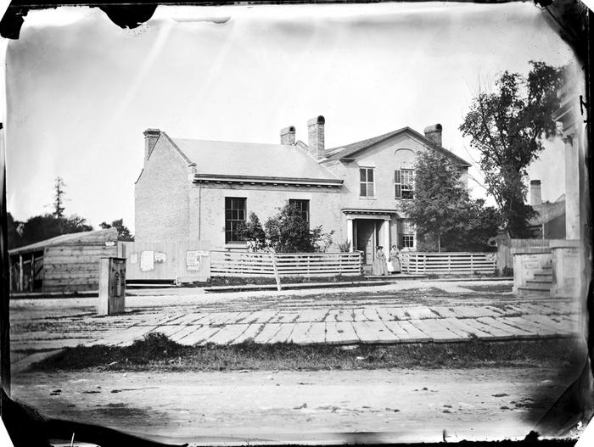
Glass negative (GN-0325)
Bank of British North America

Slide 16
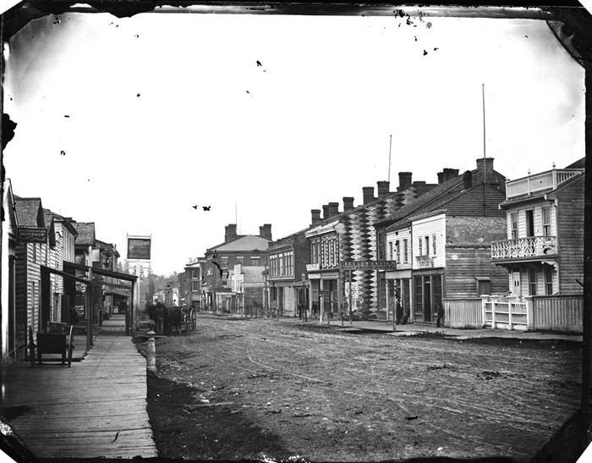
Glass negative (GN-0225)
King Street West (formerly known as Hare Street) looking east towards Cross Street.

Slide 17
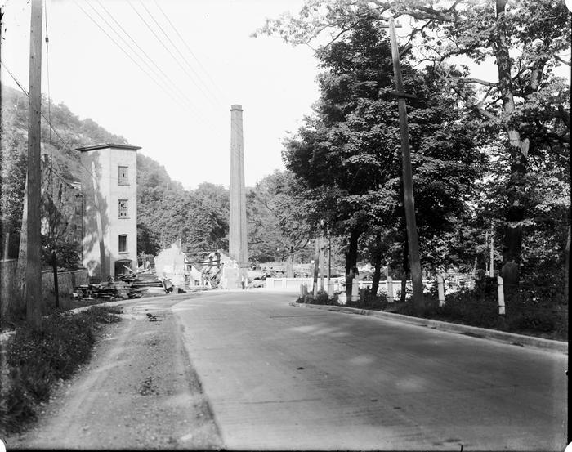
Glass negative (GN-0328)
Demolition of Fisher's Mill

Slide 18
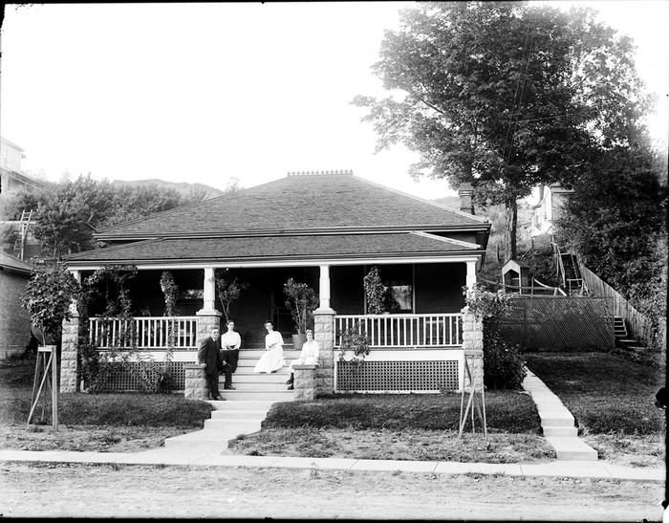
Glass negative (GN-0329)
Unidentified cottage

Slide 19
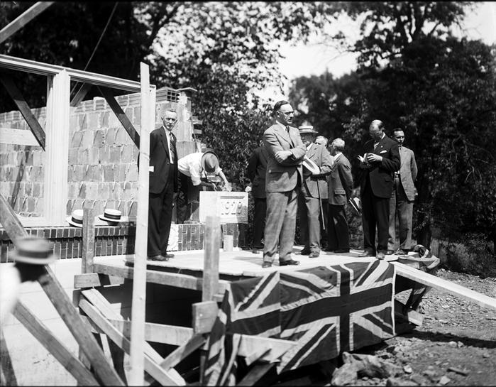
Glass negative (GN-0330)
Laying the cornerstone of the Dundas High School

Slide 20
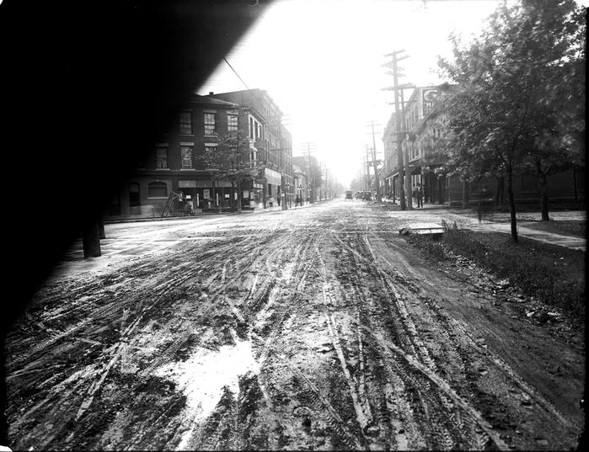
Glass negative (GN-0331)
King Street looking west from Cross and Main Streets

Slide 21
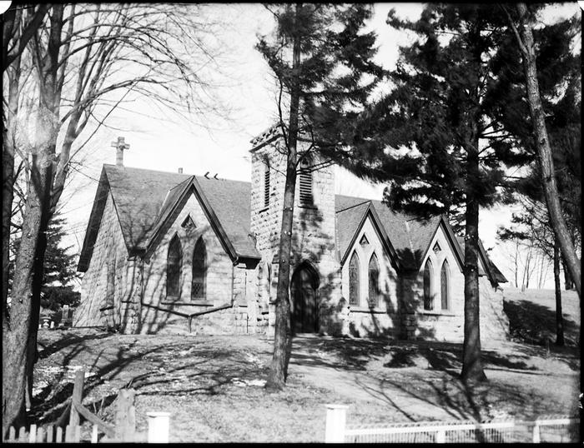
Glass negative (GN-0332)
Christ Church, Flamborough

Slide 22
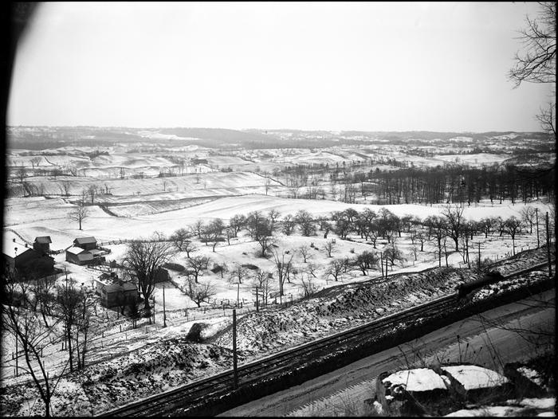
Glass negative (GN-0333)
Woodley Farm

Slide 23
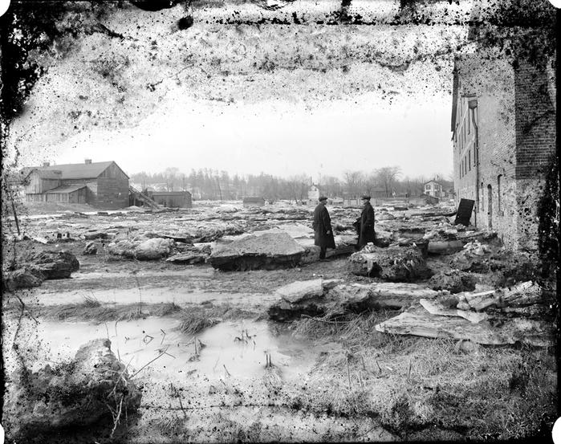
Glass negative (GN-0334)
Debris from flooding at the Desjardins Canal Turning Basin

Slide 24
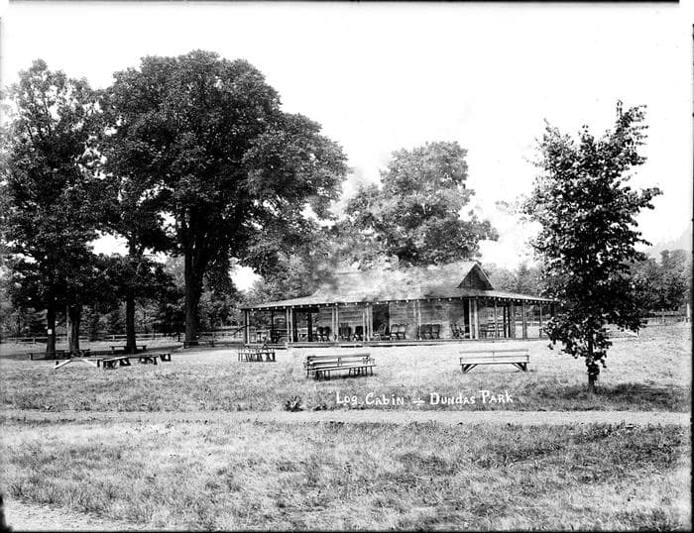
Glass negative (GN-0335)
Log Cabin at Dundas Driving Park

Slide 25
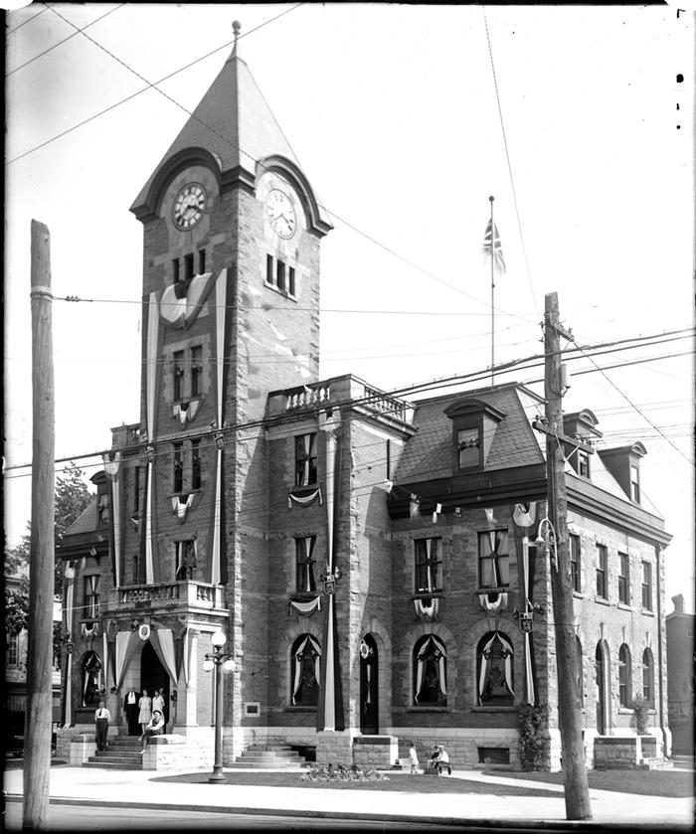
Glass negative (GN-0337)
Post Office

Slide 26
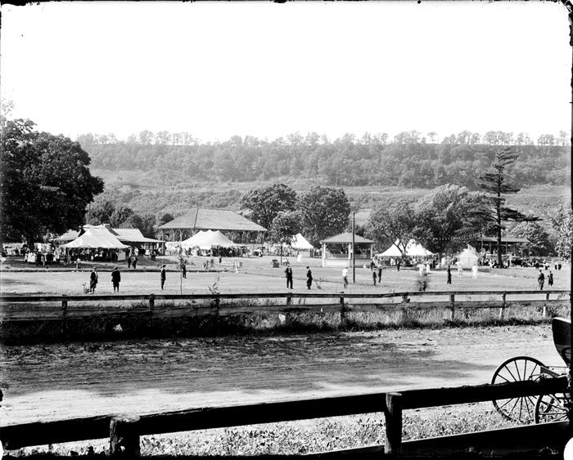
Glass negative (GN-0338)
Summer at the Dundas Driving Park

Slide 27
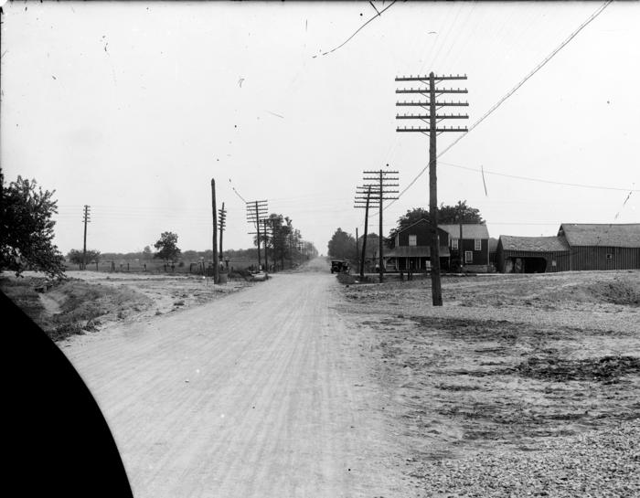
Glass negative (GN-0351)
Clappison's Corners

Slide 28
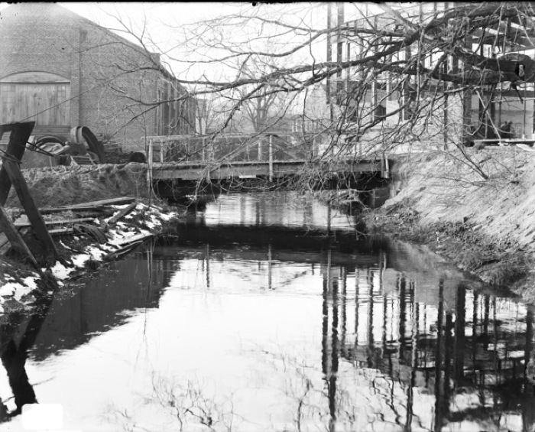
Glass negative (GN-0047)
Mill race on Spencer Creek

Slide 29
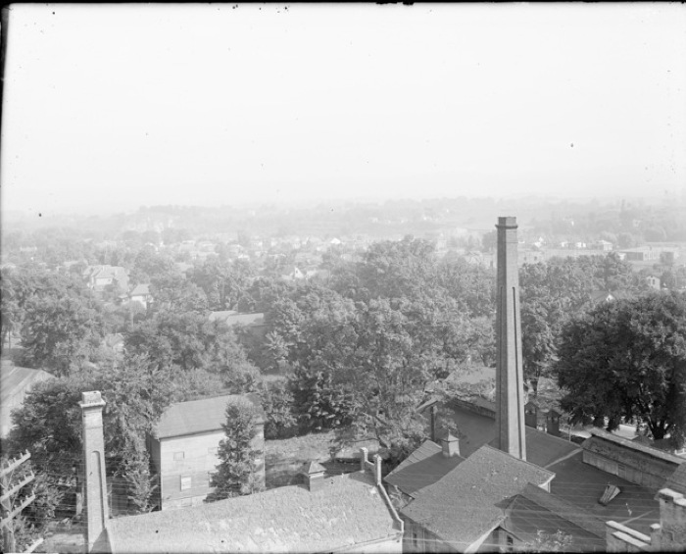
Glass negative (GN-0048)
View of Dundas

Slide 30
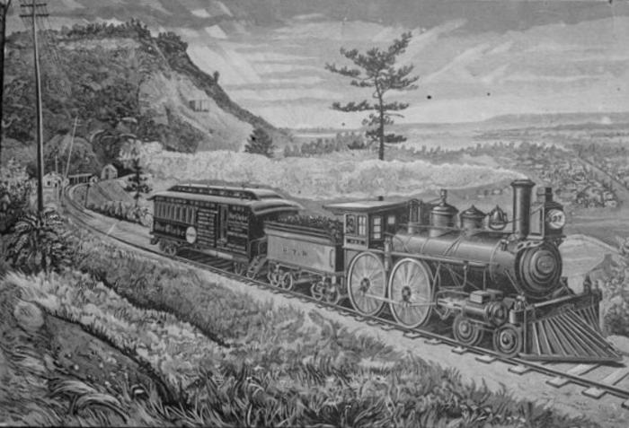
Glass negative (GN-0221)
Drawing of a train in the Dundas Valley

Slide 31
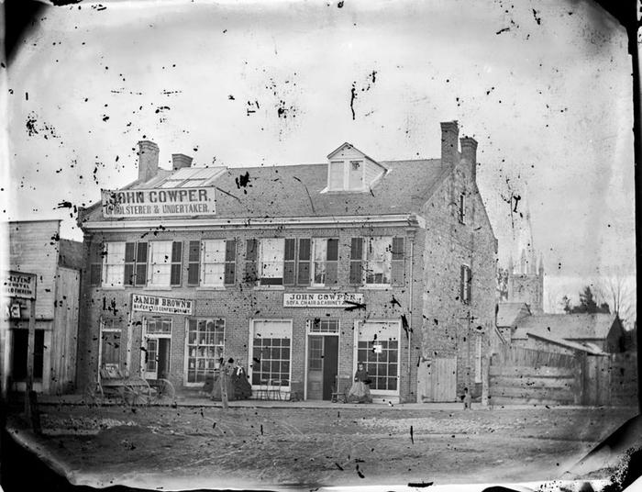
Glass negative (GN-0223)
Cowper Building

Slide 32
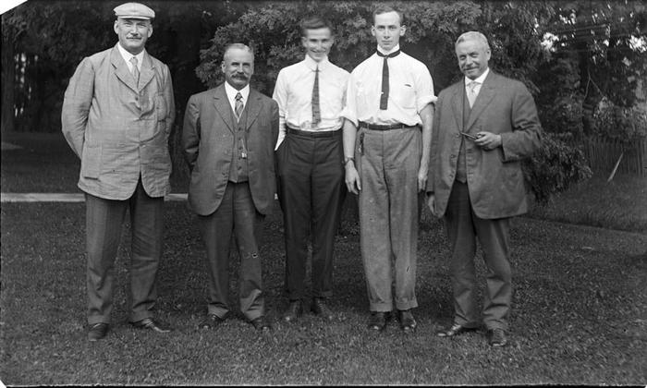
Glass negative (GN-0227)
Henry Bertram, Lennard Bertram, Aimers Bertram and others

Slide 33
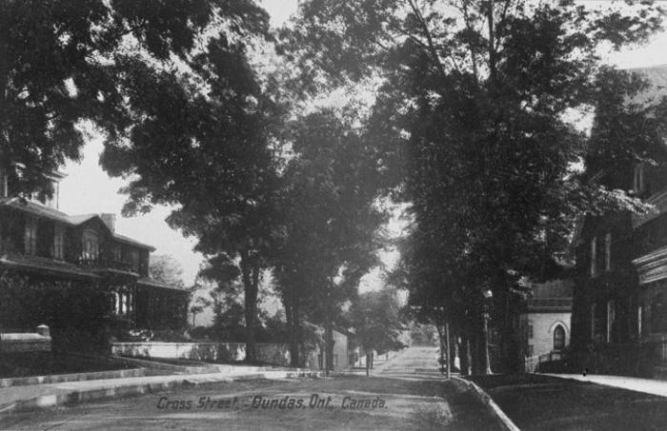
Glass negative (GN-0229)
Cross Street

Slide 34
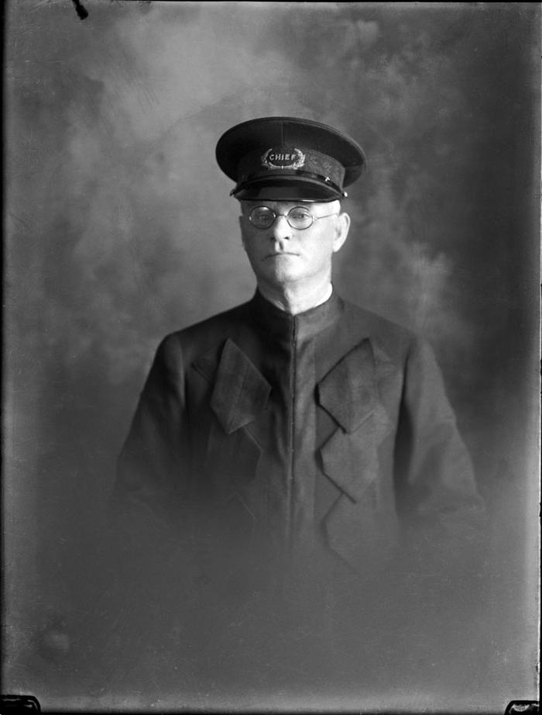
Glass negative (GN-0260)
John Lumsden, Chief of Police

Slide 35
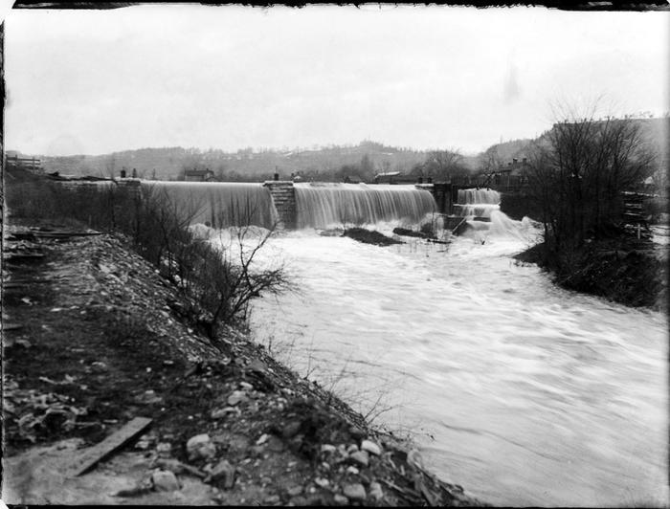
Glass negative (GN-0262)
Ewart's Dam

Slide 36
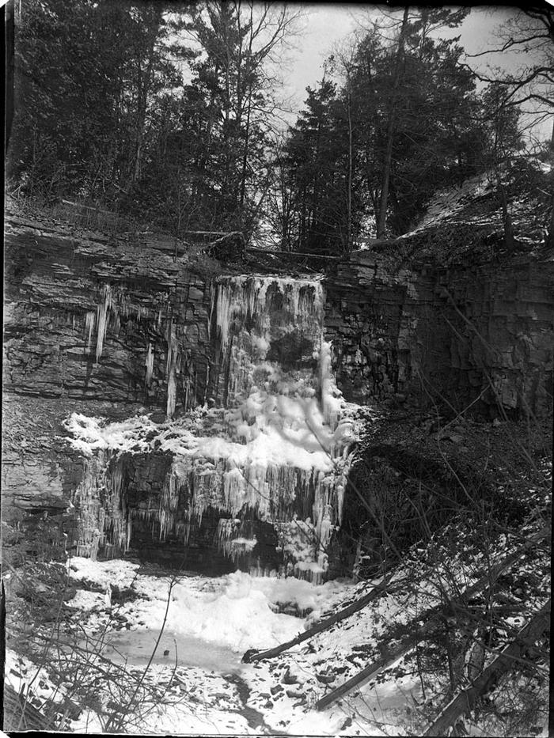
Glass negative (GN-0263)
Waterfall

Slide 37
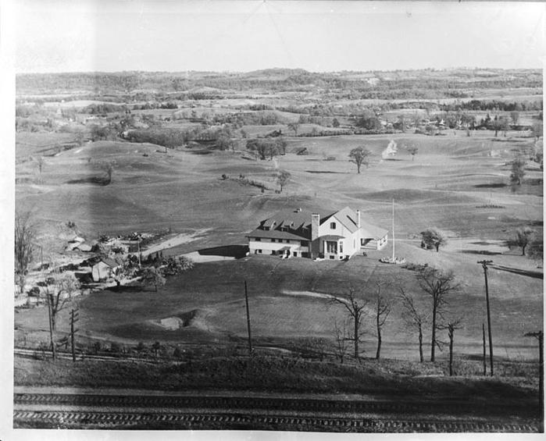
Glass negative (GN-0267)
Dundas Golf Club

Slide 38
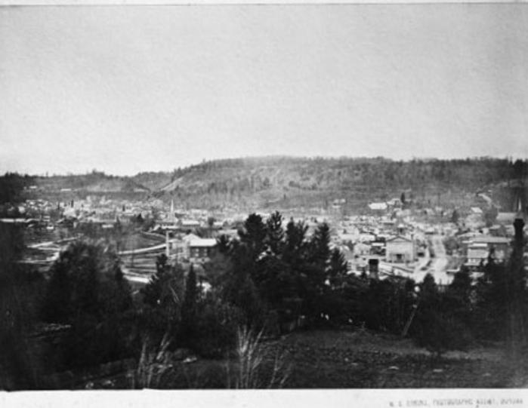
Glass negative (GN-0269)
View of Dundas

Slide 39
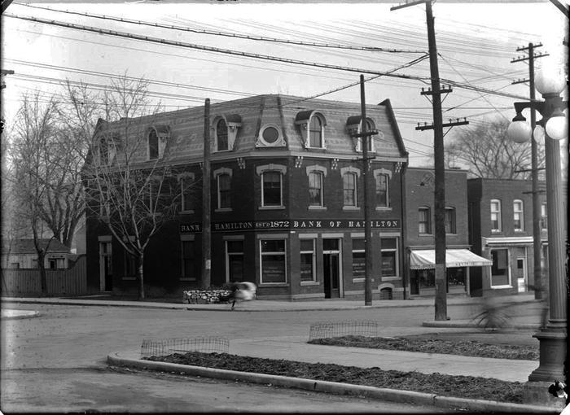
Glass negative (GN-0271)
Bank of Hamilton

Slide 40
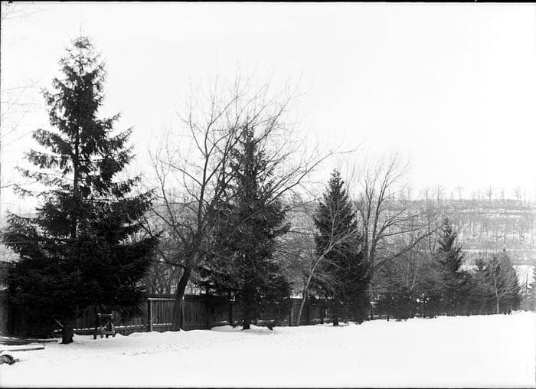
Glass negative (GN-0273)
Winter scene

Slide 41
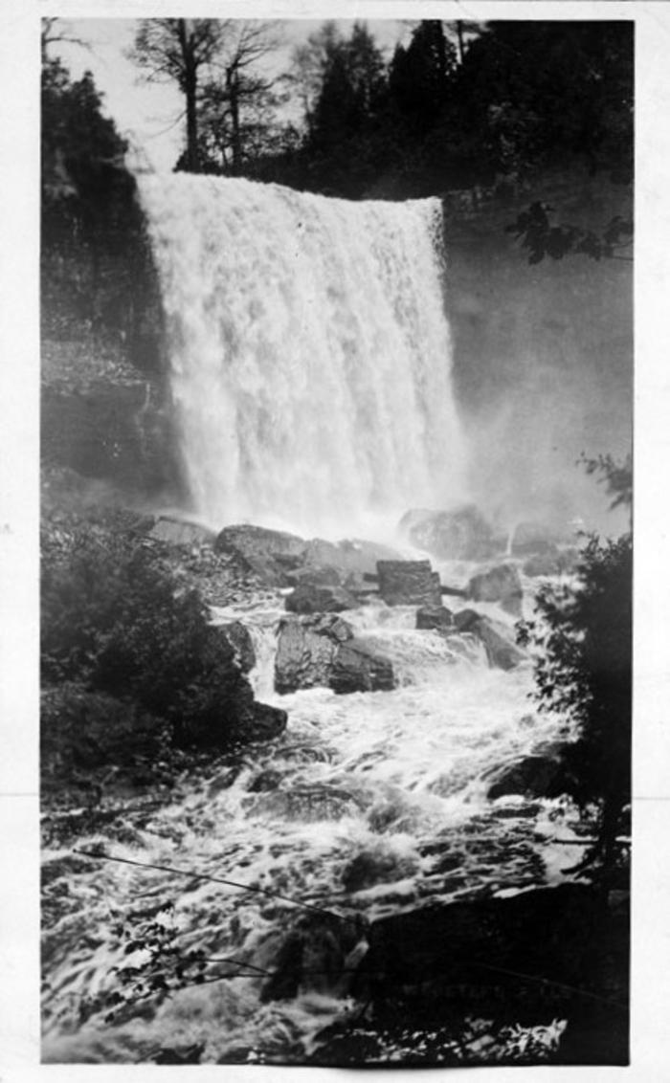
Glass negative (GN-0277)
Webster's Falls

Slide 42
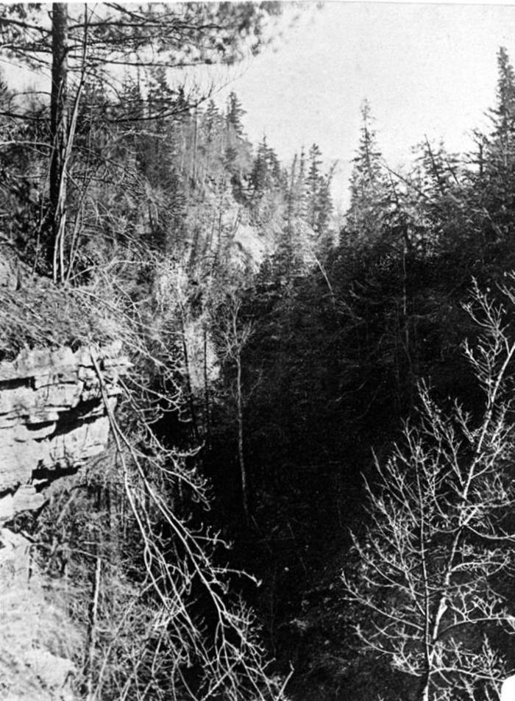
Glass negative (GN-0284)
Ravine

Slide 43
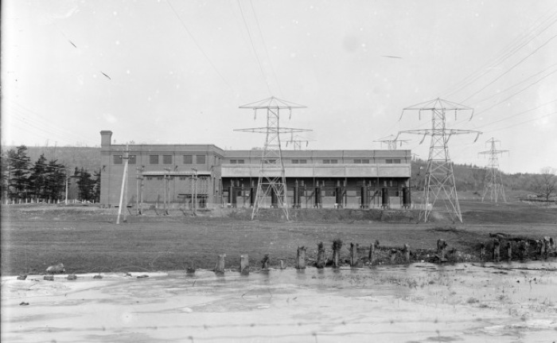
Glass negative (GN-0001)
Hydro station

Slide 44
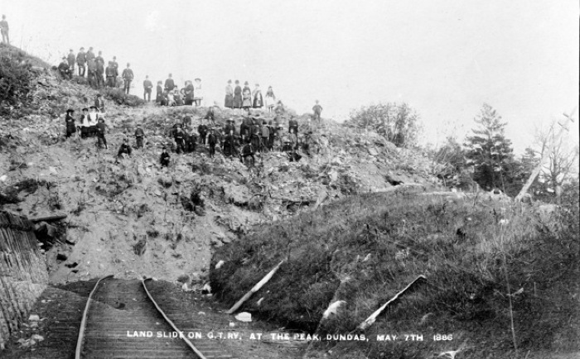
Glass negative (GN-0002)
Landslide on the Grand Trunk Railway at Dundas Peak

Slide 45
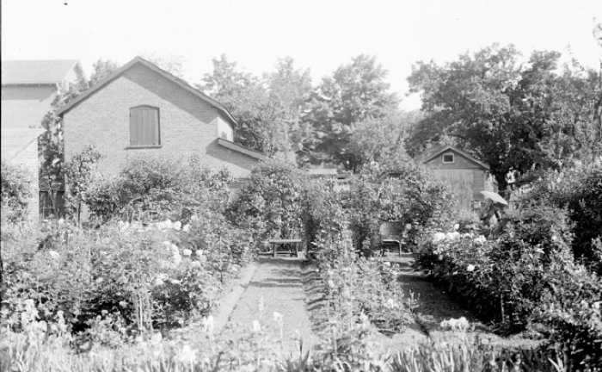
Glass negative (GN-0003)
Unidentified home and garden

Slide 46
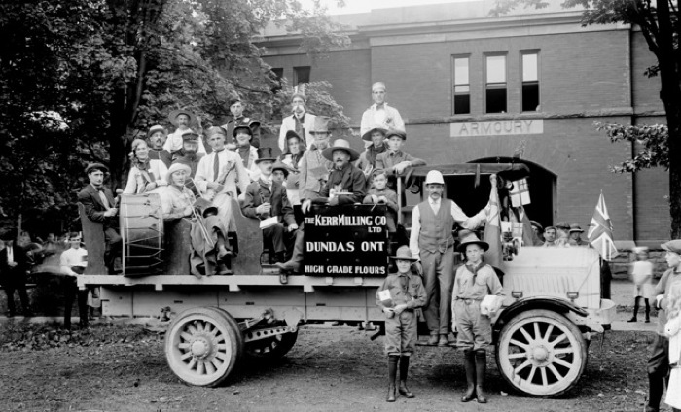
Glass negative (GN-0004)
Kerr Milling Company parade float

Slide 47
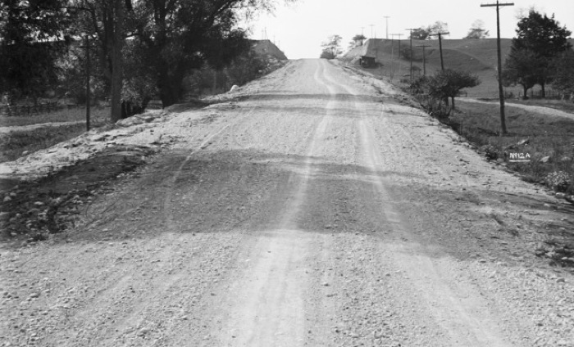
Glass negative (GN-0005)
Unidentified road

Slide 48
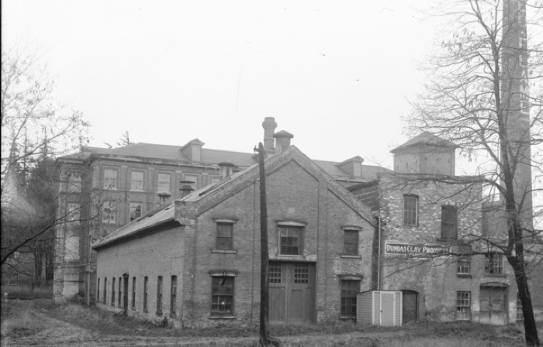
Glass negative (GN-0006)
Dundas Clay Products building

Slide 49
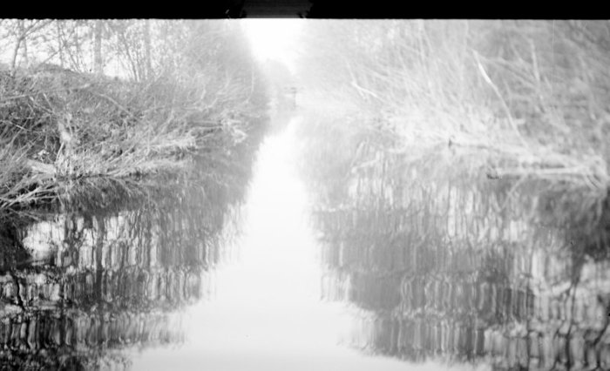
Glass negative (GN-0007)
Desjardins Canal

Slide 50
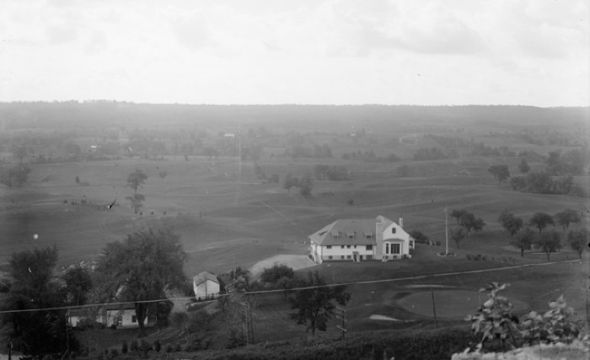
Glass negative (GN-0008)
Dundas Valley Golf Club

Slide 51
Glass negative (GN-0009)
Unidentified creek

Slide 52
Glass negative (GN-0010)
House and garden at southwest corner of King Street West and Matilda Street

Slide 53
Glass negative (GN-0011)
Dundas Fire Department

Slide 54
Glass negative (GN-0012)
House of Providence

Slide 55
Glass negative (GN-0013)
King Street looking west from Ogilvie Street

Slide 56
Glass negative (GN-0014)
View of Dundas from the Hog's Back

Slide 57
Glass negative (GN-0015)
Neu Flame building

Slide 58
Glass negative (GN-0016)
King Street West looking east from Church Street

Slide 59
Glass negative (GN-0017)
Unidentified ceremony

Slide 60
Glass negative (GN-0018)
Grafton and Co. factory at the corner of King and Cross Streets

Slide 61
Glass negative (GN-0019)
Grafton and Co. factory at the corner of King and Cross Streets with the blind policeman

Slide 62
Glass negative (GN-0020)
King Street West looking east from Church Street

Slide 63
Glass negative (GN-0021)
Lawn bowling at the Dundas Driving Park

Slide 64
Glass negative (GN-0022)
King Street West looking east from Albert Street

Slide 65
Glass negative (GN-0023)
Unidentified dilapidated house

Slide 66
Glass negative (GN-0024)
Nellie, the Fire Department's horse

Slide 67
Glass negative (GN-0025)
Dundas Central School class 1930

Slide 68
Glass negative (GN-0026)
Toronto, Hamilton and Buffalo train on Hatt Street

Slide 69
Glass negative (GN-0027)
Dundas Central School entrance class, 1931

Slide 70
Glass negative (GN-0028)
View of Highway 8 and railway tracks

Slide 71
Glass negative (GN-0029)
Jerry Hockey Team

Slide 72
Glass negative (GN-0030)
Dundas Central School entrance class 1935

Slide 73
Glass negative (GN-0031)
Landslide by Highway 8 near Dundas Train Station

Slide 74
Glass negative (GN-0032)
Unidentified church

Slide 75
Glass negative (GN-0033)
Unidentified rural road

Slide 76
Glass negative (GN-0034)
Dundas Post Office

Slide 77
Glass negative (GN-0035)
Canada Crushed Stone Co.

Slide 78
Glass negative (GN-0036)
Christ Church, Flamborough

Slide 79
Glass negative (GN-0037)
Dundas Central School Entrance Class, 1930

Slide 80
Glass negative (GN-0038)
Dundas Central School entrance class

Slide 81
Glass negative (GN-0039)
Dundas Central School entrance class

Slide 82
Glass negative (GN-0040)
Dundas Central School Entrance Class 1929

Slide 83
Glass negative (GN-0041)
Parade on King Street

Slide 84
Glass negative (GN-0042)
Unidentified road

Slide 85
Glass negative (GN-0043)
View of Dundas from the Hog's Back

Slide 86
Glass negative (GN-0044)
Ellen Osler Memorial Home

Slide 87
Glass negative (GN-0045)
Firemen's Arch

Slide 88
Glass negative (GN-0046)
Unidentified garden

Slide 89
Glass negative (GN-0049)
View of the Canada Crushed Stone Co. operation

Slide 90
Glass negative (GN-0050)
Red Lion Hotel

Slide 91
Glass negative (GN-0051)
Valley City Seating Co. with Hamilton & Dundas Train

Slide 92
Glass negative (GN-0052)
St. Augustine's Roman Catholic Church

Slide 93
Glass negative (GN-0053)
Unidentified garden

Slide 94
Glass negative (GN-0054)
Unidentified road

Slide 95
Glass negative (GN-0055)
Northwest corner of King and Sydenham Streets

Slide 96
Glass negative (GN-0056)
Riley House

Slide 97
Glass negative (GN-0057)
Unidentified derelict house

Slide 98
Glass negative (GN-0058)
Parade in celebration of the Relief of Mafeking

Slide 99
Glass negative (GN-0059)
Turning Basin at the Desjardins Canal

Slide 100
Glass negative (GN-0060)
St. Augustine' Roman Catholic Church

Slide 101
Glass negative (GN-0061)
Gathering at the Dundas Driving Park

Slide 102
Glass negative (GN-0063)
Grafton and Co. factory

Slide 103
Glass negative (GN-0065)
The Armouries

Slide 104
Glass negative (GN-0066)
Highway 8

Slide 105
Glass negative (GN-0067)
Sydenham Road (possibly)

Slide 106
Glass negative (GN-0068)
Creighton Road

Slide 107
Glass negative (GN-0069)
R.K. Kernighan (aka The Khan) in front of his log cabin

Slide 108
Glass negative (GN-0070)
The gates to Springhill

Slide 109
Glass negative (GN-0071)
Knox Presbyterian Church

Slide 110
Glass negative (GN-0072)
View of Dundas

Slide 111
Glass negative (GN-0073)
Dundas Soldiers' Memorial in Memorial Square

Slide 112
Glass negative (GN-0074)
Dundas Soldiers' Memorial in Memorial Square

Slide 113
Glass negative (GN-0075)
Workers at Doolittle and Wilcox Crushed Stone Co.

Slide 114
Glass negative (GN-0076)
This photograph shows a view of Dundas taken from Hog's Back looking north across Spencer Creek.

Slide 115
Glass negative (GN-0077)
View of Dundas

Slide 116
Glass negative (GN-0078)
Ewart's Dam

Slide 117
Glass negative (GN-0080)
Cowper Block

Slide 118
Glass negative (GN-0079)
Ewart's Dam

Slide 119
Glass negative (GN-0082)
Music Hall

Slide 120
Glass negative (GN-0083)
Gore Mills (Fisher's Paper Mill) from Highway 8

Slide 121
Glass negative (GN-0081)
Moving Kappheim's store on the corner of King and Foundry Streets

Slide 122
Glass negative (GN-0084)
Fisher's Mill

Slide 123
Glass negative (GN-0085)
Osler Drive

Slide 124
Glass negative (GN-0086)
John Bertram and Sons Co. foundry on Hatt Street

Slide 125
Glass negative (GN-0087)
View of Dundas from the Hog's Back

Slide 126
Glass negative (GN-0088)
Thornton Family band

Slide 127
Glass negative (GN-0089)
Home at 45 Melville Street

Slide 128
Glass negative (GN-0090)
Greenwood Family crest

Slide 129
Glass negative (GN-0091)
Basketball team

Slide 130
Glass negative (GN-0092)
Dundas Salvation Army Band

Slide 131
Glass negative (GN-0093)
Post Office built in 1913

Slide 132
Glass negative (GN-0094)
Unidentified road during flooding

Slide 133
Glass negative (GN-0095)
Wading Pool at the Dundas Driving Park

Slide 134
Glass negative (GN-0096)
Building at 14 Cross Street

Slide 135
Glass negative (GN-0097)
Binkley Union Church

Slide 136
Glass negative (GN-0098)
Clappison's cut on Highway 6

Slide 137
Glass negative (GN-0099)
Fowlie's Bakery

Slide 138
Glass negative (GN-0100)
Haley House at Rockton. Address is 791 Rockton Road.

Slide 139
Glass negative (GN-0101)
Melbourne Hotel

Slide 140
Glass negative (GN-0102)
Canada Crushed Stone Co.

Slide 141
Glass negative (GN-0103)
Winter flooding

Slide 142
Glass negative (GN-0104)
Canada Crushed Stone Co.

Slide 143
Glass negative (GN-0105)
Canada Crushed Stone Co.

Slide 144
Glass negative (GN-0106)
Unidentified garden

Slide 145
Glass negative (GN-0107)
Unidentified rural road

Slide 146
Glass negative (GN-0108)
Unidentified rural road

Slide 147
Glass negative (GN-0109)
Unidentified road

Slide 148
Glass negative (GN-0110)
Unidentified road

Slide 149
Glass negative (GN-0111)
Unidentified rural road

Slide 150
Glass negative (GN-0112)
Plains Road Hill

Slide 151
Glass negative (GN-0113)
Unidentified road

Slide 152
Glass negative (GN-0114)
Unidentified derelict house

Slide 153
Glass negative (GN-0115)
Unidentified derelict house

Slide 154
Glass negative (GN-0116)
Dundas Driving Park

Slide 155
Glass negative (GN-0117)
Thornton family band

Slide 156
Glass negative (GN-0118)
Knox Presbyterian Church Ladies Aid picnic

Slide 157
Glass negative (GN-0119)
Construction of Clappison's cut

Slide 158
Glass negative (GN-0120)
Osler Drive

Slide 159
Glass negative (GN-0121)
Unidentified street

Slide 160
Glass negative (GN-0122)
1 Melville Street

Slide 161
Glass negative (GN-0123)
Turning Basin at the Desjardins Canal

Slide 162
Glass negative (GN-0124)
Morden's mill

Slide 163
Glass negative (GN-0125)
Dundas Central School

Slide 164
Glass negative (GN-0126)
Gathering in the Dundas Driving Park

Slide 165
Glass negative (GN-0127)
Canada Crushed Stone Co.

Slide 166
Glass negative (GN-0128)
Parade on King Street

Slide 167
Glass negative (GN-0129)
Canada Crushed Stone Co. operation

Slide 168
Glass negative (GN-0130)
George Rolph property marker

Slide 169
Glass negative (GN-0131)
Dundas Train Station

Slide 170
Glass negative (GN-0132)
View of Dundas from the Hog's Back

Slide 171
Glass negative (GN-0133)
Dundas Fire Department

Slide 172
Glass negative (GN-0134)
Fowlie's Bakery

Slide 173
Glass negative (GN-0135)
Highway King bus

Slide 174
Glass negative (GN-0136)
Cotton Mill and Chapman Engine Co.

Slide 175
Glass negative (GN-0137)
View of Dundas from the Hog's Back

Slide 176
Glass negative (GN-0138)
Toronto, Hamilton and Buffalo train on Hatt Street

Slide 177
Glass negative (GN-0139)
Bridge construction at Binkley's Hollow

Slide 178
Glass negative (GN-0140)
Cotton Mill

Slide 179
Glass negative (GN-0141)
Dundas and Hamilton Bus Line bus

Slide 180
Glass negative (GN-0142)
Dundas Axe Works

Slide 181
Glass negative (GN-0143)
Hamilton and Dundas Railway train

Slide 182
Glass negative (GN-0144)
Train with passenger car "Dummy #2" at the Hamilton and Dundas Railway station on Foundry Street

Slide 183
Glass negative (GN-0145)
J. Enright stagecoach

Slide 184
Glass negative (GN-0146)
Creighton Road

Slide 185
Glass negative (GN-0147)
View of Dundas from the Hog's Back

Slide 186
Glass negative (GN-0148)
Kerr Milling Company

Slide 187
Glass negative (GN-0149)
Dundas Cotton Mill building

Slide 188
Glass negative (GN-0150)
Dundas Cotton Mill

Slide 189
Glass negative (GN-0151)
Hamilton and Dundas Railway cars

Slide 190
Glass negative (GN-0152)
Dundas Fire Department

Slide 191
Glass negative (GN-0153)
Property by Osler Drive and the Cotton Mill

Slide 192
Glass negative (GN-0154)
Unidentified derelict mill

Slide 193
Glass negative (GN-0155)
Neu Flame (Canada) Ltd. building at the Dundas Cotton Mill

Slide 194
Glass negative (GN-0156)
Demolition of Fisher's Mill

Slide 195
Glass negative (GN-0157)
Entrance to the Dundas Driving Park

Slide 196
Glass negative (GN-0158)
Carnegie Library

Slide 197
Glass negative (GN-0159)
Grafton's store and factory

Slide 198
Glass negative (GN-0160)
Grafton's store and factory

Slide 199
Glass negative (GN-0161)
Dundas Public Utilities building

Slide 200
Glass negative (GN-0162)
Unidentified bridge

Slide 201
Glass negative (GN-0163)
King Street West

Slide 202
Glass negative (GN-0164)
King Street West

Slide 203
Glass negative (GN-0165)
King Street West

Slide 204
Glass negative (GN-0166)
Municipal Christmas Tree

Slide 205
Glass negative (GN-0167)
King Street West

Slide 206
Glass negative (GN-0168)
Edward Freeborn

Slide 207
Glass negative (GN-0169)
Picnic at Sulphur Springs

Slide 208
Glass negative (GN-0170)
Mrs. Edward Freeborn

Slide 209
Glass negative (GN-0171)
Dan Duggan

Slide 210
Glass negative (GN-0172)
Rev. John Bates

Slide 211
Glass negative (GN-0173)
James McQueen

Slide 212
Glass negative (GN-0174)
Dundas Public Utilities Commission

Slide 213
Glass negative (GN-0175)
James R. Sutherland

Slide 214
Glass negative (GN-0176)
Rev. Egerton Ryerson

Slide 215
Glass negative (GN-0177)
William A. Ward

Slide 216
Glass negative (GN-0178)
"Jerry" Duggan

Slide 217
Glass negative (GN-0179)
Rev. E.A. Irving

Slide 218
Glass negative (GN-0180)
Ann Lesslie Holt

Slide 219
Glass negative (GN-0181)
Unidentified house

Slide 220
Glass negative (GN-0182)
Home of W.A. Davidson at 157 Melville Street

Slide 221
Glass negative (GN-0183)
Rev. G.M. Meacham

Slide 222
Glass negative (GN-0184)
Amelia Trescothic Hobson and Oliver Hobson

Slide 223
Glass negative (GN-0188)
Unidentified man in a kilt

Slide 224
Glass negative (GN-0189)
Unidentified couple

Slide 225
Glass negative (GN-0190)
Unidentified man

Slide 226
Glass negative (GN-0191)
John B. Williams

Slide 227
Glass negative (GN-0192)
Brady house

Slide 228
Glass negative (GN-0193)
Landslide on the Grand Trunk Railway at Dundas Peak

Slide 229
Glass negative (GN-0194)
Margaret Mason

Slide 230
Glass negative (GN-0195)
Unidentified woman and man

Slide 231
Glass negative (GN-0196)
[Sherman Falls]

Slide 232
Glass negative (GN-0198)
Entrance to the House of Providence

Slide 233
Glass negative (GN-0199)
Dr. James McMahon, MPP

Slide 234
Glass negative (GN-0200)
77th Wentworth Regiment marching band

Slide 235
Glass negative (GN-0201)
Unidentified woman

Slide 236
Glass negative (GN-0202)
Unidentified group of children.

Slide 237
Glass negative (GN-0203)
[Dave Mitson]

Slide 238
Glass negative (GN-0205)
Unidentified man

Slide 239
Glass negative (GN-0206)
Image of the Lesslie tokens

Slide 240
Glass negative (GN-0207)
Sons of England

Slide 241
Glass negative (GN-0208)
Aftermath of the fire at St. Paul's United Church

Slide 242
Glass negative (GN-0210)
Lesslie coffee urn

Slide 243
Glass negative (GN-0212)
George Rolph property marker

Slide 244
Glass negative (GN-0213)
Dundas' first municipal Christmas tree

Slide 245
Glass negative (GN-0214)
Ellen Osler Memorial Home

Slide 246
Glass negative (GN-0215)
J.R. Seavey's painting of the Dundas Valley from the Toll Gate

Slide 247
Glass negative (GN-0218)
Two unidentified men, possibly firefighters

Slide 248
Glass negative (GN-0219)
Brown's barbershop

Slide 249
Glass negative (GN-0220)
Dundas Valley

Slide 250
Glass negative (GN-0222)
Girl with sheep

Slide 251
Glass negative (GN-0224)
Cat

Slide 252
Glass negative (GN-0226)
Lesslie tokens

Slide 253
Glass negative (GN-0228)
Henry Bertram, Aimers Bertram and others

Slide 254
Glass negative (GN-0230)
Entrance to Dundas Park

Slide 255
Glass negative (GN-0231)
An unidentified man outside a large building

Slide 256
Glass negative (GN-0232)
Unidentified group of children

Slide 257
Glass negative (GN-0233)
Two unidentified women next to a creek

Slide 258
Glass negative (GN-0235)
Unidentified group of people with a dog

Slide 259
Glass negative (GN-0236)
Unidentified group of people with a dog

Slide 260
Glass negative (GN-0237)
Unidentified man

Slide 261
Glass negative (GN-0240)
[Jenny Bertram] in a garden

Slide 262
Glass negative (GN-0241)
Henry Bertram, Lennard Bertram, A.E.R. Turner, and others

Slide 263
Glass negative (GN-0242)
[Jenny Bertram] in a garden

Slide 264
Glass negative (GN-0268)
Dundas Driving Park in the winter

Slide 265
Glass negative (GN-0274)
Unidentified man

Slide 266
Glass negative (GN-0275)
Waterfall and stream

Slide 267
Glass negative (GN-0276)
Riverbank

Slide 268
Glass negative (GN-0281)
Grafton & Co. store

Slide 269
Glass negative (GN-0283)
House of Providence

Slide 270
Glass negative (GN-0290)
William Notman

Slide 271
Glass negative (GN-0291)
William MacFarlane "Porky" Campbell

Slide 272
Glass negative (GN-0294)
Bessie Ridler

Slide 273
Glass negative (GN-0304)
Group of unidentified women

Slide 274
Glass negative (GN-0306)
Entrance to the House of Providence

Slide 275
Glass negative (GN-0307)
A portrait of J.H. Bowman, W.E. Lyons, W.A. Davidson and W.H. Moss

Slide 276
Glass negative (GN-0308)
A portrait of W.A. Davidson, W.H. Moss, W.E. Lyons and J.H. Bowman

Slide 277
Glass negative (GN-0313)
Rev. John MacCall

Slide 278
Glass negative (GN-0314)
Clementina Fessenden

Slide 279
Glass negative (GN-0315)
Maria L. King

Slide 280
Glass negative (GN-0316)
Two men in a horse-drawn carriage

Slide 281
Glass negative (GN-0317)
Jane Giles

Slide 282
Glass negative (GN-0322)
Three men with a horse and buggy

Slide 283
Glass negative (GN-0327)
Desjardins Canal

Slide 284
Glass negative (GN-0336)
The Khan's house

Slide 285
Glass negative (GN-0339)
Remains of the Dundas Electric Light and Power Company operation after the fire of 1901

Slide 286
Glass negative (GN-0340)
A group of tennis players having a picnic

Slide 287
Glass negative (GN-0341)
Bridge at Fisher's Mill

Slide 288
Glass negative (GN-0342)
Spencer Creek

Slide 289
Glass negative (GN-0343)
Wagon accident

Slide 290
Glass negative (GN-0344)
Horse-drawn parade float

Slide 291
Glass negative (GN-0345)
Victoria Street

Slide 292
Glass negative (GN-0346)
Valley City Seating Co. parade float

Slide 293
Glass negative (GN-0347)
Valley City Seating Co. parade float

Slide 294
Glass negative (GN-0348)
Dundas Fire Hall

Slide 295
Glass negative (GN-0349)
A view of Dundas

Slide 296
Glass negative (GN-0350)
Borer's Falls

